Slide 1


FY 2023 DHS / FEMA
Homeland Security Grant Program
Roll Out Webinar
APRIL 17, 2023

Slide 2
FY 2023 Homeland Security Grant Program (HSGP)
Agenda
  FY 2023 HSGP Overview
  DHS Requirements
  Projects to be Considered
  Application Process Milestones
  Application Process Timeline
  How to Apply
  Post-Award Requirements
    Environmental and Historical Preservation (EHP)
    Grant Administration
    National Cyber Security Review (NCSR)
  Reminders
  Questions
  Contact Information
2

Slide 3
FY 2023 Homeland Security Grant Program (HSGP)
FY 2023 HSGP Overview
To build, sustain, and deliver core capabilities to achieve the National Preparedness Goal of a secure and resilient Nation.
Gaps are identified during the Threat and Hazard Identification and Risk Assessment (THIRA) process and assessed in the State Preparedness Report (SPR).
Funding sustains current capability levels and fills identified gaps in Planning, Organization, Equipment, Training, and Exercise activities in order to prevent, protect against, mitigate, respond to, and recover from acts of terrorism or catastrophic events.
The Non-Disaster Grant program related to this roll-out is the Homeland Security Grant Program (HSGP) also sometimes known as “SHSP.”
3

Slide 4
FY 2023 Homeland Security Grant Program (HSGP)
DHS Requirements
The Department of Homeland Security continues to mandate certain projects be funded according to National Priorities. For this year, the following priorities will be addressed with statutory funding:
Enhancing the protection of Soft Targets/Crowded Places
  (e.g. Deployable Message Board/Camera Trailer)
Enhancing Information & Intelligence Sharing and analysis
Combating Domestic Violent Extremism
Enhancing Cybersecurity
Enhancing Election Security
Enhancing Community Resilience
  (e.g. CERT)
4

Slide 5
Projects to be Considered
FY 2023 Homeland Security Grant Program (HSGP)
80% of program funding is invested for supporting efforts such as Cyber, Fusion Center, Regional Teams, Interoperable Communications, Radiological, CBRNE/WMD, HAZMAT, Exercise, Soft Target Protection, Public Information and Notification.
Eligible THIRA related projects:
RISCON Communications Projects
  Note: RIEMA will not fund handheld portable radios.
Community Preparedness and Resilience (CERT)
Soft Target/Crowded Places - Notification/Messaging/Camera Trailer
Preparedness Supplies/Equipment
Planning, Trainings or Exercises
No construction will be considered by RIEMA
No Cost Share / No Match Required
7

Slide 6
Application Process Milestones
FY 2023 Homeland Security Grant Program (HSGP)
Application Start: April 17,2023
Applications Due: May 5, 2023
Applicants Notified of Grant Determination:
  No Later than September 23, 2023
Period of Performance Start:
  October 1, 2023
Period of Performance End:
  December 31, 2024
  POP End Dates may vary depending upon the nature and scope of projects.
8

Slide 7



Application Process Timeline
FY 2023 Homeland Security Grant Program (HSGP)
APRIL 1, 2023
RIEMA opens application form in portal. Applicants begin creating accounts in the GMS/eCivis system.
  RIEMA begins collecting applications for review
Preparation
  RIEMA applies for the HSGP Program through grants.gov. no later than
  APRIL 14, 2023.
APRIL 17, 2023
RIEMA hosts Conference Call with State and Local partners announcing process for prescreening.
PowerPoint to placed on RIEMA website after brief.
9

Slide 8



Application Process Timeline (cont’d)
FY 2023 Homeland Security Grant Program (HSGP)
May 5, 2023
RIEMA closes application portal.
May 18, 2023
RIEMA submits application package for federal funding.
September 9, 2023 – September 19, 2023
RIEMA reviews applications and selects projects to be funded.
*If necessary for funding determinations, RIEMA may also issue requests for information during this time.
April 17, 2023 – May 5, 2023
RIEMA accepts formal applications (POETE model) through the GMS/eCivis portal.
September 19, 2023 – September 30, 2023
RIEMA begins award process.
October 1, 2023
Award letters with related grant packages are sent to sub-recipients.
10

Slide 9
How to Apply
FY 2023 Homeland Security Grant Program (HSGP)
RIEMA is using a portal system for grant applications accessible through the RIEMA website located at: www.riema.ri.gov
Multiple projects require multiple applications:
  e.g. Local CERT team funding using HSGP would require its own application while an application for a message board trailer would need one as well.
This process is similar to the Department of Homeland Security’s application process requirements for States.
11

Slide 10
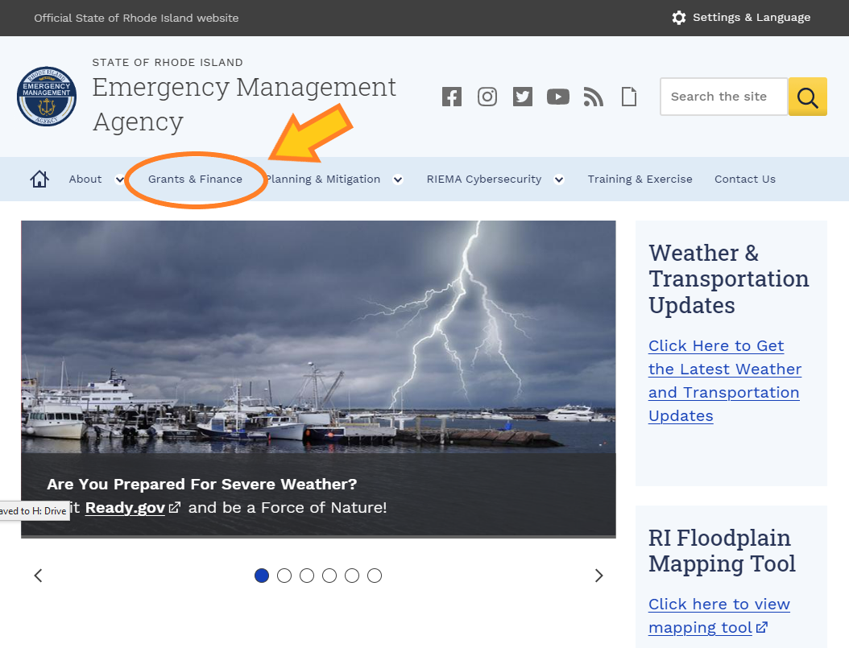
How To Apply - Site Navigation
12

Slide 11
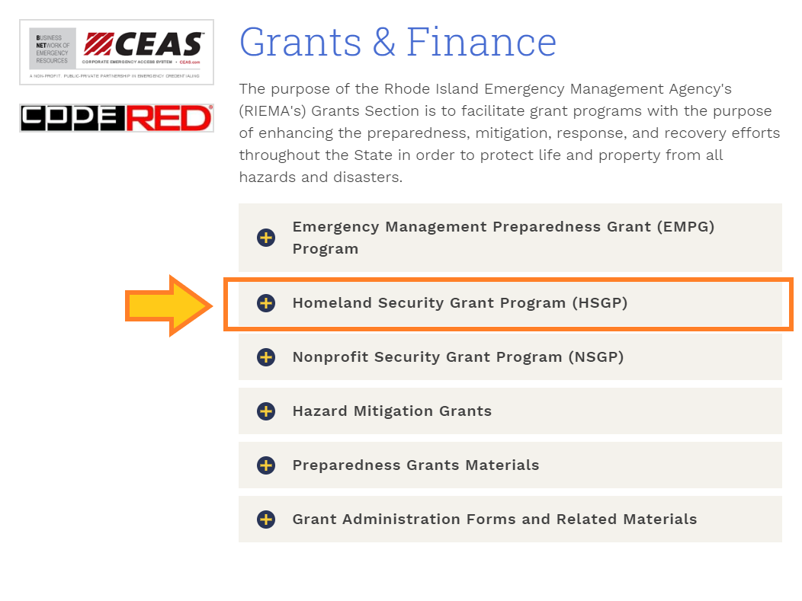
How To Apply - Site Navigation
13

Slide 12
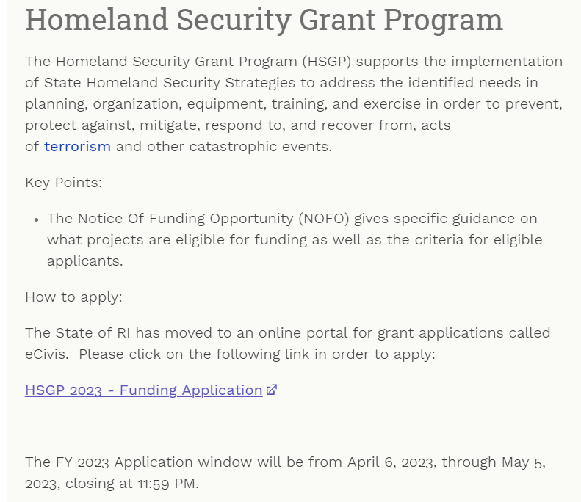
FY 2023 Homeland Security Grant Program (HSGP)
15

Slide 13
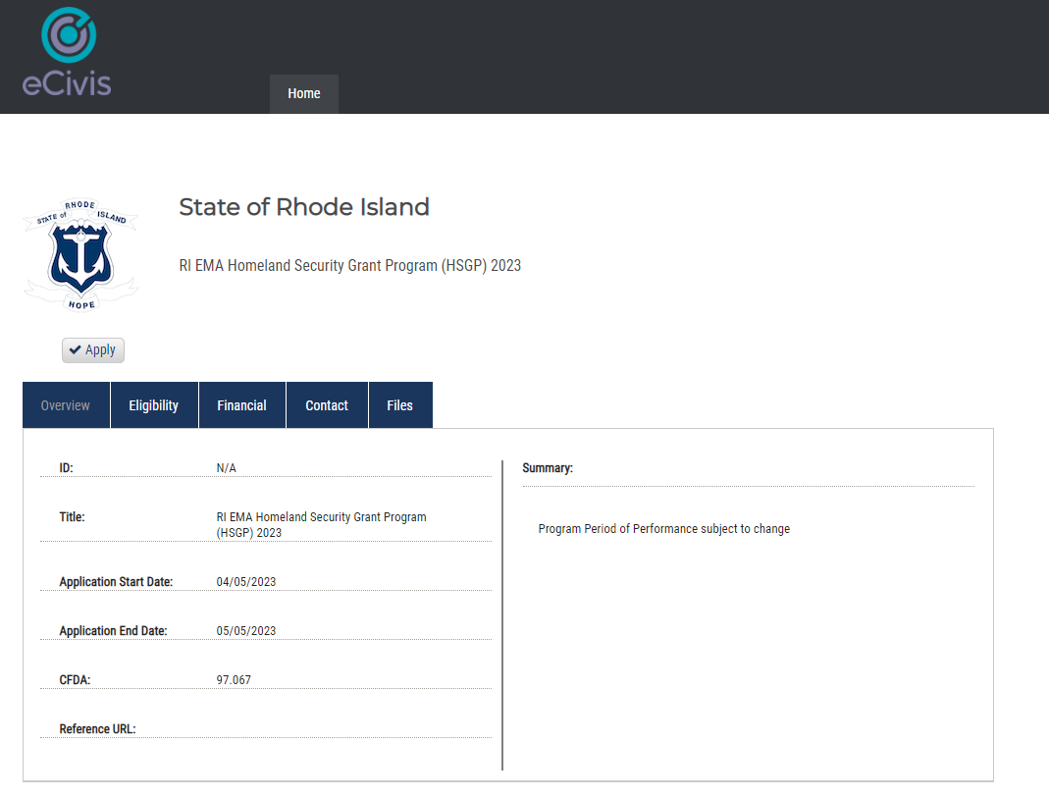
FY 2023 Homeland Security Grant Program (HSGP)
15

Slide 14
How to Apply (cont’d)
FY 2023 Homeland Security Grant Program (HSGP)
Applicants must apply for each project. Each project must have a budget figure(s) included. All fields need to be completed in order to submit. No applications will be accepted after the portal closes. Applicants are limited to three (3) project applications for submission.
A review process will be used to evaluate projects that fit into the State Emergency Management Strategy.
Applicants are required to be registered in the System for Award Management (SAM) and to use of your local Unique Entity Identifier (UEI), formerly known as a Data Universal Numbering System (DUNS) number. Please contact your city controller to determine the correct municipal UEI number to use.
To ascertain whether or not your city is properly registered in SAM’s go to: https://www.sam.gov
14

Slide 15
How to Apply (cont’d)
FY 2023 Homeland Security Grant Program (HSGP)
All applicants will receive a notification of determination. Your notification may place requirements on your application, e.g. more information is needed concerning your project or you may be required to provide more milestones. The notification may also include an obligation/declination of award. The application process includes:
POETE allocations
Budget projection
Goals/ Milestones
  Note: Please include 4 milestones in the application.
Project implementation
Project Management requirements
15

Slide 16
Environmental and Historic Preservation (EHP)
Post-Award Requirements
DHS/FEMA is required to consider the effects of its actions on the environment and/or historic properties:
Including but not limited to construction of communication towers, modification or renovation of existing buildings, structures and facilities, or new construction including replacement of facilities.
Involves the submission of a detailed project description that explains the goals and objectives of the proposed project along with supporting documentation.
Documentation required includes GPS coordinates, ground level and overhead photographs (screenshot from web-based map program), and detailed drawings.
Any project with construction or installation related work must undergo EHP review – from mounting television monitors on walls to installation of a generator.
16

Slide 17
Grant Administration
Post-Award Requirements (cont’d)
New requirements when purchasing technical items (Prohibitions on Expending FEMA Award Funds for Covered Telecommunications Equipment or Services).
Nationwide Cyber Security Review (NCSR) – still applicable: Confirmation will be due to RIEMA by December 16, 2023. Failure to comply with the NCSR requirements may result in termination of the entire grant agreement.
  Cybersecurity Assessment – ongoing requirement - FY 2023 recipients and subrecipients will be required to complete the NCSR, which is open annually from October to December, by the end of calendar year 2023 in order for agencies to benchmark and measure progress of improving their cybersecurity posture. The Chief Information Officer (CIO), Chief Information Security Officer (CISO), or equivalent for each recipient and subrecipient should complete the NCSR. If there is no CIO or CISO, the most senior cybersecurity professional should complete the assessment.
Quarterly reports need to be submitted timely within the GMS portal.
17

Slide 18
REMINDERS
FY 2023 Homeland Security Grant Program (HSGP)
Resources are limited, there are new requirements to fund specific areas as directed by the Department of Homeland Security.
Not all projects can be funded.
No partially-funded projects will be considered.
Construction Projects will not be funded.
Please submit your Nationwide Cyber Security Review (NCSR) as soon as possible.
18

Slide 19
FY 2023 Homeland Security Grant Program (HSGP)
Questions?
Thank you for your participation!
19

Slide 20
FY 2023 Preparedness Grant Programs
Rhode Island Emergency Management Agency
645 New London Avenue
Cranston, RI 02920
Phone: (401) 946-9996
Fax: (401) 944-1891
More information may be located at: http://www.riema.ri.gov
Questions may be directed to: ema.grants@ema.ri.gov
Other Points of Contact:
Tim Nadeau: timothy.nadeau@ema.ri.gov
Denise Manni: denise.manni@ema.ri.gov
20

