Slide 1


FY 2023 Emergency
Preparedness Grant Program (EMPG)Roll-Out
APRIL 26, 2023 (11AM EST)

Slide 2
2023 Preparedness Grant Programs
Agenda
  EMPG Overview
  Requirements
  EMPG Notes
  How to Apply
  Environmental and Historical Preservation (EHP)
  Grant Administration
  Reminders
  Questions and Answers
  Contact Information
2

Slide 3
2023 Preparedness Grant Programs
EMPG Grant Overview
To assist local units of government in building, sustaining, and delivering a whole community emergency management program.
EMPG funding result of the Stafford Act
State-wide gaps are identified during the Threat and Hazard Identification and Risk Assessment (THIRA) process and assessed in the State Preparedness Report (SPR).
Funding sustains current capability levels and fills identified gaps in Planning, Organization, Equipment, Training, and Exercise activities in order to prevent, protect against, mitigate, respond to, and recover from acts of terrorism or catastrophic events.
3

Slide 4
2023 Preparedness Grant Programs
EMPG Grant Overview (continued)
These funds are used as pass-through funding for the State, Local, and Tribal Assistance (SLA) program:
  Used to support local emergency management efforts including personnel, EOCs, communications, and local emergency management capability enhancement.
4

Slide 5
2023 Preparedness Grant Programs
EMPG Requirements
All EMPG funded personnel shall complete either the Independent Study courses identified in the Professional Development Series (PDS) or attend the National Emergency Management Basic Academy (NEMBA) delivered either by the Emergency Management Institute (EMI) or at a sponsored state, local, tribal, territorial, regional or other designated location.
5

Slide 6
2023 Preparedness Grant Programs
EMPG Requirements
Must have a current Hazard Mitigation Plan or complete a plan and submit to RIEMA no later than October 1, 2024.
Participate in two State Emergency Operations Center trainings during the grant period of performance.
  RIEMA will post information on when trainings will take place on the RIEMA website.
  RIEMA will also email EMD’s relative to the trainings.
Maintain access and reporting within the RIEMA WebEOC tool.
  Login to WebEOC at least once per quarter.
  Maintain Activity logs as appropriate during activations
  Maintain contact information for your jurisdiction.
5

Slide 7
PDS vs. NEMBA
Professional Development Series
Independent Study (IS)
National Emergency Management
Basic Academy (NEMBA)
    IS-100: Intro to the Incident Command System (ICS)
    IS-200: Basic Incident Command System for Initial Response
    IS-700: Intro to the National Incident Management System
    IS-800: Intro to National Response Framework
    IS-120: An Introduction to Exercises
    IS-230: Fundamentals of Emergency Management
    IS-235: Emergency Planning
    IS-240: Leadership and Influence
    IS-241: Decision Making and Problem Solving
    IS-242: Effective Communication
    IS-244: Developing and Managing Volunteers
    IS-100: Intro to the Incident Command System (ICS)
    IS-200: Basic Incident Command System for Initial Response
    IS-700: Intro to the National Incident Management System
    IS-800: Intro to National Response Framework
    IS-29: Public Information Officer Awareness (prerequisite for E/L0105)
    IS-230: Fundamentals of Emergency Management
    E/L0101: Foundations of Emergency Management
    E/L0102: Science of Disaster
    E/L0103: Planning – Emergency Operations
    E/L0104: Exercise Design
    E/L0105: Public Information Basics
    E/L/K0146: Homeland Security Exercise & Evaluation (HSEEP) Training
-OR-
6

Slide 8
2023 Preparedness Grant Programs
EMPG FY 2023 Notes
Salary expenses must be matched through municipal funds depicted in a budget document, line item in the budget, or similar document.
  For personnel fulfilling a dual role, the organization must demonstrate the ability to identify the difference between non-EMA and EMA duties/costs
Third party or “in-kind” match must be outlined in the application and pre-approved by RIEMA prior to award; in-kind cannot be used as salary, planning, or equipment match
Construction projects will not be considered during this round of grant award funding.
Prior to a grant award being issued, perspective sub-recipients will have to submit the personnel/positions to be funded and certification that the required courses, under the EMPG program, are completed.
7

Slide 9
2023 Preparedness Grant Programs
EMPG Projects for Consideration
The RIEMA EMPG program is directed at local units of government in order to maintain and sustain an active Emergency Management Preparedness posture.
Projects include:
Funding for personnel such as the EMA Director or EMA staff for a local Emergency Management program
Sustainment of the program involving day to day expenses
CERT team establishment, sustainment, and training
Allowable costs also include Interoperable Communications Equipment; Interoperable Communications Plans; EOC Equipment; Evacuation route plans;
Limited Equipment per Authorized Equipment List – Equipment may not be third party/in-kind matched
8

Slide 10
2023 Preparedness Grant Programs
Projects for consideration need to meet RIEMA’s vision for a well-prepared whole community participation in planning, response, recovery and mitigation through addressing state priorities.
More information about the State EMPG allocations may be found on the RIEMA website located at: www.riema.ri.gov including the Notice of Funding Opportunity (NOFO)
9

Slide 11
How to Apply
RIEMA is using an online system for grant applications accessible through the RIEMA website located at: www.riema.ri.gov
Once you access the RIEMA website, click on the Grants Finance Section and scroll down to the EMPG Grant banner in order to apply for EMPG.
Multiple projects require multiple applications, E.g., Local CERT team funding using EMPG would require an application, while a local EMA Directors salary requires an additional EMPG application.
10

Slide 12
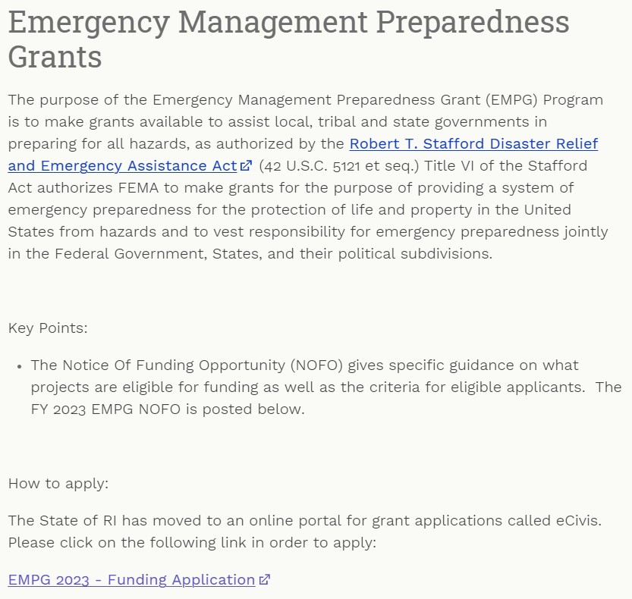
How to Apply (cont’d)
11

Slide 13
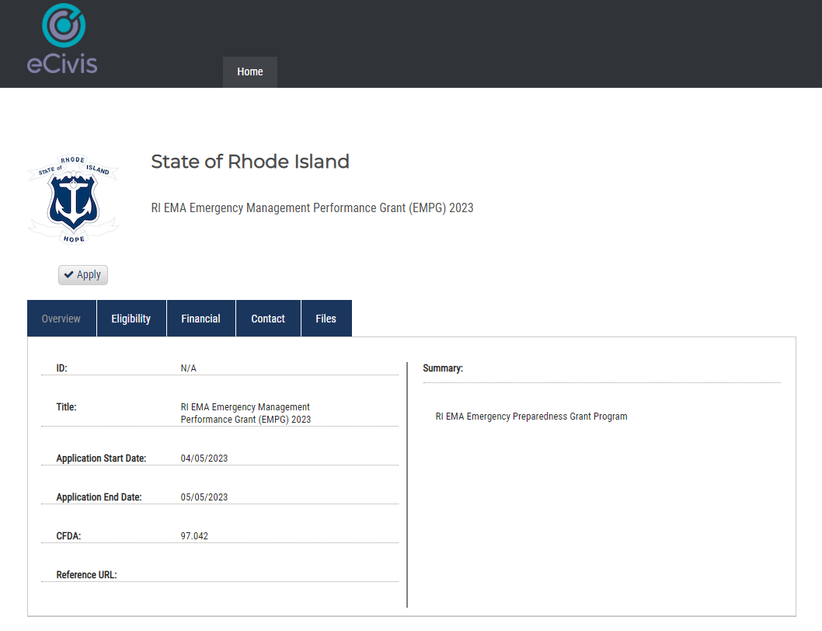
How to Apply (cont’d)
11

Slide 14
How to Apply (cont’d)
Applicants must apply online at www.riema.ri.gov. An application is due for each project. Each project must have a budget figure(s) included. All fields need to be completed in order to submit. No applications will be accepted after the portal closes. Applicants are limited to three (3) projects.
Applicants will require being registered in the System for Award Management (SAM’s) and use of your local Unique Entity Identifier (UEI)/ formerly known as a Data Universal Numbering System (DUNS) number – please contact your city controller to determine the correct municipal UEI number to use.
To ascertain whether or not your city is properly registered in SAM’s go to: https://www.sam.gov. Entities that create a private profile for the UEI in SAM will need to send a copy of the active UEI to RIEMA.
11

Slide 15
How to Apply (cont’d)
Subsequent notification from RIEMA may place requirements on your application or you may be required to provide more milestones. The application process includes:
  POETE
  Budget
  Goals/ Milestones – note please include 4 milestones in the application
  Project implementation
  Project Management requirements
  Assurance forms, to include EHP information and other requirements
  Project is related to RIEMA program guidance
12

Slide 16
2023 Preparedness Grant Programs - Administration
EMPG 2023 Timeline
Applications Due: 5/5/2023
  (11:59 p.m. Eastern Standard Time)
Application Timeline 4/17/2023 to 5/5/2023
Awards 9/1/2023 to 9/30/2023
Period of Performance Start: 10/1/2023
Period of Performance End: 9/30/2024
13

Slide 17
2023 Preparedness Grant Programs
Environmental and Historic Preservation (EHP)
DHS/FEMA is required to consider the effects of its actions on the environment and/or historic properties:
Including but not limited to construction of communication towers, modification or renovation of existing buildings, structures and facilities, or new construction including replacement of facilities.
Involves the submission of a detailed project description that explains the goals and objectives of the proposed project along with supporting documentation.
Documentation required includes GPS coordinates, ground level and overhead photographs (screenshot from web-based map program), and detailed drawings.
16

Slide 18
REMINDERS
Program funding is a win.
Resources are limited, prudent/allowable funding requests are a priority.
Not all projects can be funded.
Past funding does not guarantee future funding.
If the funding disappears next cycle, what is your plan to sustain what you have?
Ensure that your application for funding aligns with the guidance.
Complete EHP requirements in a timely fashion.
Submit reimbursement requests in a timely fashion; funding may be swept once the period of performance has ended.
17

Slide 19
REMINDERS (cont’d)
Readiness: Begins at the local level and ends at the local level.
FEMA Requirements:
  NIMS Training
  Shall complete either the Independent Study courses identified in the Professional Development Series or the National Emergency Management Basic Academy
State Requirements EMPG:
  Maintain NIMS Compliance for the community
  Maintain WebEOC username and password; monthly log-in ;
  Other requirements may apply
EMPG Match: 50/50
18

Slide 20
2023 Preparedness Grant Programs
  Questions?
19

Slide 21
2023 Preparedness Grant Programs
Rhode Island Emergency Management Agency
645 New London Avenue
Cranston, RI 02920
24-hour Phone: (401) 946-9996
Fax: (401) 944-1891
More information may be located at: http://www.riema.ri.gov
Questions may be directed to: ema.grants@ema.ri.gov
Other Points of Contact:
Tim Nadeau: timothy.nadeau@ema.ri.gov; 401-462-7535
Denise Manni: denise.manni.ctr@ema.ri.gov; 401-462-7114
20

