Slide 1
Rhode Island Nonprofit Security Grant Program

Slide 2
2023 Nonprofit Security Grant Program
AGENDA
Overview of NSGP
Eligibility
Eligible Applicants At High-Risk of Terror Attack
Funding Guidelines
Key Changes
Security Self-Assessment
Sample: Question & Option for Consideration
Priority Areas, Core Capabilities and Lifelines
Allowable & Unallowable Costs
Application Process
Application Excerpts
Reported Application Issue
Investment Justification Requirements
Environmental & Historic Preservation (Post Award)
Site Navigation
Contact Information & Questions

Slide 3
2023 Nonprofit Security Grant Program
OVERVIEW
Nonprofit Security Grant Program (NSGP) provides funding support for target hardening and other physical security enhancements to nonprofit organizations that are at high-risk of terrorist attack. This is a reimbursement-based grant program.
The Rhode Island Emergency Management Agency (RIEMA) is the only entity in Rhode Island that may submit FY 2023 NSGP applications (Investment Justifications) directly to the Department of Homeland Security (DHS) / Federal Emergency Management Agency (FEMA).
All applications from eligible nonprofits within the state for FY 2023 NSGP funding must be submitted to RIEMA (EMA.Grants@ema.ri.gov). Final award decisions will be made by DHS/FEMA not RIEMA.

Slide 4
2023 Nonprofit Security Grant Program
ELIGIBLE NSGP APPLICANTS
Only 501(c)(3) Nonprofit organizations at high-risk of terrorist attack.
Applicants must provide proof of 501(c)(3) status or
Provide letter of exemption from IRS/Department of the Treasury.
Applicants must self-identify as one of the following:
Ideology-based/Spiritual/Religious
Educational
Medical
Other

Slide 5
2023 Nonprofit Security Grant Program
ELIGIBLE APPLICANTS AT HIGH-RISK OF TERRORIST ATTACK
May include, but is not limited to:
Identification and substantiation of prior threats or attacks by a terrorist organization, network, or cell against the applicant or closely related organizations;
Symbolic value of the site(s) as a highly recognized national or historical institution that renders the site as possible target of terrorism;
Role of the applicant in responding to or recovering from terrorist attacks;
Findings from previously conducted risk assessments including threat or vulnerability, police reports and/or insurance claims.

Slide 6
2023 Nonprofit Security Grant Program
FUNDING GUIDELINES
NSGP allowable costs are focused on target hardening activities. Funding can be used for the acquisition and installation of security on real property (including buildings and improvements) owned or leased by the nonprofit organization, specifically for prevention of and/or protection against the risk of a terrorist attack.
The equipment is limited to two categories: Physical Security Enhancement Equipment (AEL Section 14) and Inspection & Screening Systems (AEL Section 15).

Slide 7
2023 Nonprofit Security Grant Program
KEY CHANGES
States may no longer establish a cap on individual subawards that differs from the maximum award amount determined by FEMA. The maximum award amount remains at $150,000 per site for up to three sites, for a potential total of $450,000 per nonprofit organization.
Security Self-Assessment Form (aka Vulnerability Assessment)
Bonus Review Points
Underserved Communities
Nonprofit organizations located within an underserved community will have up to 15 points added to their project review score. FEMA will use the Centers for Disease Control and Prevention’s Social Vulnerability Index (SVI) tool to determine each sub-applicant’s social vulnerability ranking. Sub-applicants in communities with a “High” SVI ranking will receive 10 additional points, and sub-applicants in communities with a “Very High” SVI ranking will receive 15 additional points.
New Recipients
Nonprofit organizations that have not previously received NSGP funding will have 15 points added to their project score.
Notes:
Score Multipliers remain the same:
Total Score x 3 = Final Score (Faith-based Organizations/Houses of Worship)
Total Score x 2 = Final Score (Medical and Educational Institutions)
Total Score x 1 = Final Score (All other entity types)

Slide 8
Security Self-Assessment Form

Slide 9
Security Self-Assessment Form
SAMPLE: Question & Option for Consideration

Slide 10
2023 Nonprofit Security Grant Program
Priority Areas | Core Capabilities Enhanced | Lifelines | Example Project Types
National Priorities
Enhancing the Protection of Soft Targets/Crowded Places | Operational coordination Public information and warning Intelligence and Information Sharing Interdiction and disruption Screening, search, and detection Access control and identity verification Physical protective Measures Risk management for protection programs and activities | Safety & Security | Private contracted security guards Physical security enhancements Closed circuit television (CCTV) security cameras Security screening equipment for people and baggage Access controls Fencing, gates, barriers, etc.
Enduring Needs
Planning | Planning Risk management for protection programs & activities Risk & disaster resilience assessment Threats and hazards identification Operational coordination | Safety & Security | Conduct or enhancement of security risk assessments Assessment of capabilities and gaps in planning for the needs of persons with disabilities and others with access and functional needs Development of: Security plans and protocols Emergency contingency plans Evacuation/shelter in place plans
Training & Awareness | Long Term Vulnerability Reduction Public Information and Warning | Safety & Security | Active shooter training, including integrating the needs of persons with disabilities Security training for employees Public awareness/preparedness campaigns
Exercises | Long-term vulnerability reduction | Safety & Security | Response exercises

Slide 11
2023 Nonprofit Security Grant Program
ALLOWABLE COSTS
Management and Administration (M&A) Costs up to 5% of sub-grant award are allowed.
Internal payroll policies and procedures are subject to review.
Authorized Officials acting as Project Managers cannot attest for own time.
Planning activities related to the development of plans such as Response Plans, Continuity of Operations.
Equipment costs for access control equipment, surveillance, physical protective measures.
Training and Exercises (security-related) costs are allowed.
Allowable training topics: physical security, target hardening, terrorism awareness/employee preparedness, active shooter.
Maintenance & Sustainment related costs such as maintenance contracts, warranties, repair or replacement costs, upgrades, user fees, as defined in DHS/FEMA Policy FP 205-402-125-1.

Slide 12
Allowable Costs – AEL & Other
14CI-00-COOP: System, Information Technology Contingency Operations
14EX-00-BCAN: Receptacles, Trash, Blast-Resistant
14EX-00-BSIR: Systems, Building, Blast/Shock/Impact Resistant
14SW-01-ALRM: Systems/Sensors, Alarm
14SW-01-DOOR: Doors and Gates, Impact Resistant
14SW-01-LITE: Lighting, Area, Fixed
14SW-01-PACS: System, Physical Access Control
14SW-01-SIDP: Systems, Personnel Identification
14SW-01-SIDV: Systems, Vehicle Identification
14SW-01-SNSR: Sensors/Alarms, System and Infrastructure Monitoring, Standalone
14SW-01-VIDA: Systems, Video Assessment, Security
14SW-01-WALL: Barriers: Fences; Jersey Walls
15SC-00-PPSS: Systems, Personnel/Package Screening
Contract Security: Private Contract Security Personnel/Guards
M&A: Management and Administration
Planning
Exercise
Notes:
All items on ALLOWABLE COSTS – EQUIPMENT slides can be selected from a dropdown list within the NSGP 2022 application.

Slide 13
Allowable Costs – AEL & Other (cont’d)
03OE-03-MEGA: System, Public Address, Handheld or Mobile
04AP-05-CRED: System, Credentialing
04AP-09-ALRT: Systems, Public Notification and Warning
04AP-11-SAAS: Applications, Software as a Service
05AU-00-TOKN: System, Remote Authentication
05EN-00-ECRP: Software, Encryption
05HS-00-MALW: Software, Malware/Anti-Virus Protection
05HS-00-PFWL: System, Personal Firewall
05NP-00-FWAL: Firewall, Network
05NP-00-IDPS: System, Intrusion Detection/Prevention
06CP-01-PORT: Radio, Portable
06CC-02-PAGE: Services/Systems, Paging
06CP-03-ICOM: Intercom
06CP-03-PRAC: Accessories, Portable Radio
10GE-00-GENR: Generators
13IT-00-ALRT: System, Alert/Notification
21GN-00-INST: Installation
21GN-00-STAX: Sales Tax
21GN-00-TRNG: Training
Notes:
All items on ALLOWABLE COSTS – EQUIPMENT slides can be selected from a dropdown list within the NSGP 2022 application.

Slide 14
2023 Nonprofit Security Grant Program
UNALLOWABLE COSTS
Organization related costs are not allowed
Travel costs are not allowed
Operational Overtime costs are not allowed

Slide 15
2023 Nonprofit Security Grant Program
APPLICATION PROCESS/PREPARATION
Investment Justification Template
Vulnerability and Risk Assessment - Submit with the application.
Mission Statement - Submit with the application.
All applications must be submitted to RIEMA by 1:00 PM on TBD.
RIEMA submits all applications to the Department of Homeland Security for federal review, final scoring and award decisions.
Department of Homeland Security makes final award decisions in September of 2023.

Slide 16
2023 Nonprofit Security Grant Program
FEMA NSGP Application - Troubleshooting
According to Grants.gov [grants.gov], you must have the latest version of Adobe Reader and your version of Reader needs to be the same across multiple devices (if using multiple devices).
Additionally, you will need to use the “save as” function to fill out the template when downloading. The document must be saved first, and then you can open and fill out the template.
Chrome has been reported as problematic with regards to use. Nonprofits have reported having more success with Firefox and Microsoft Edge.

Slide 17
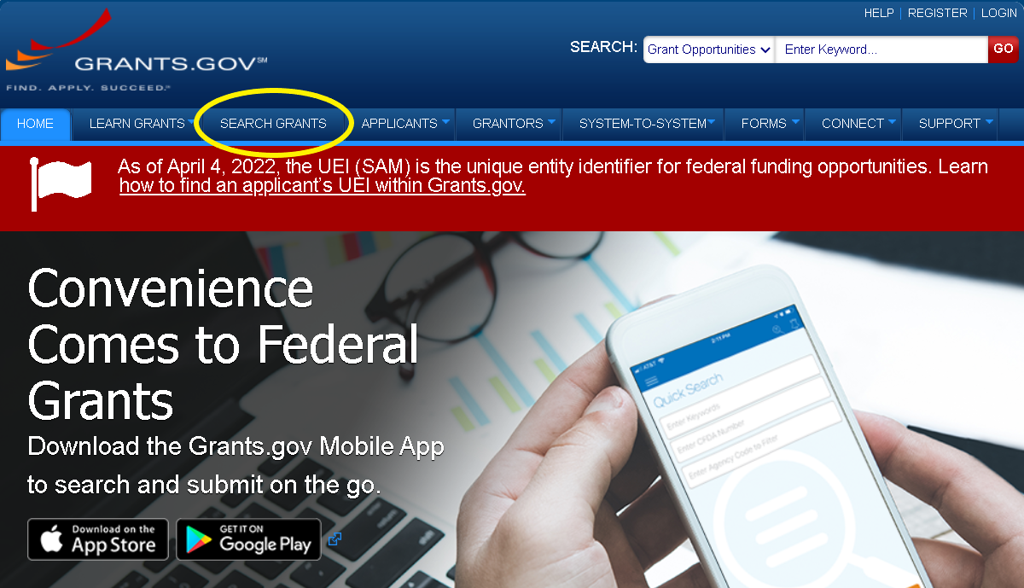

Slide 18
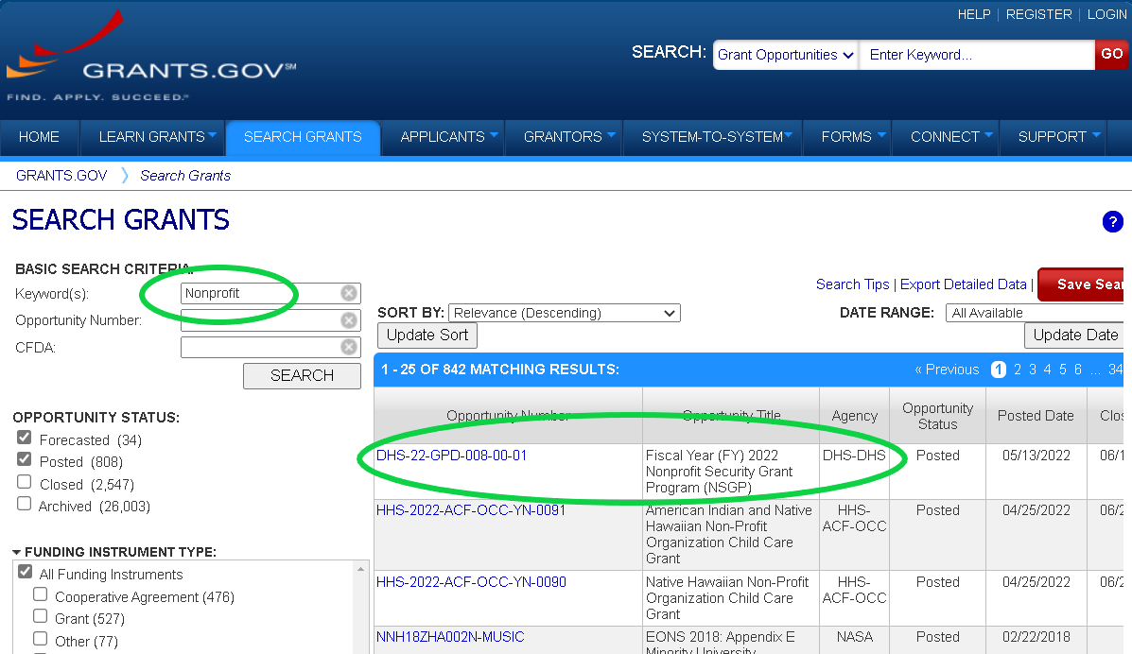

Slide 19
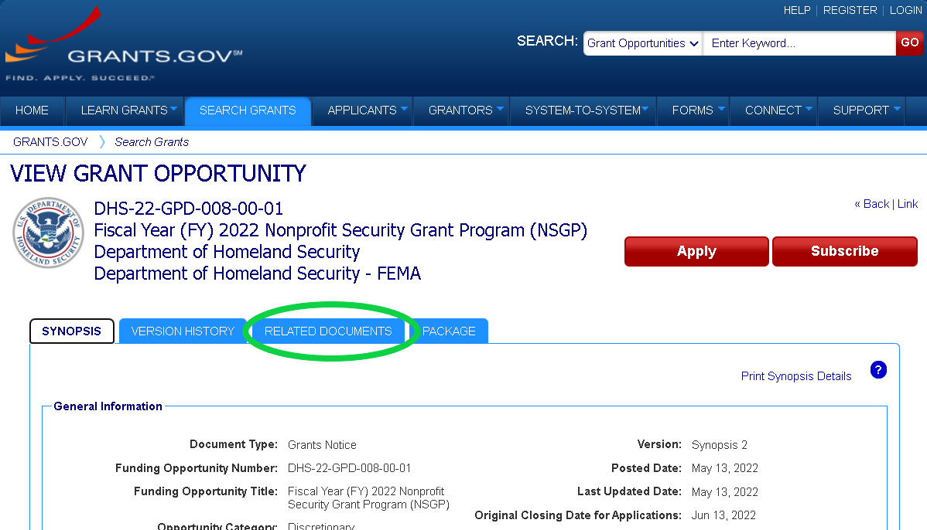

Slide 20
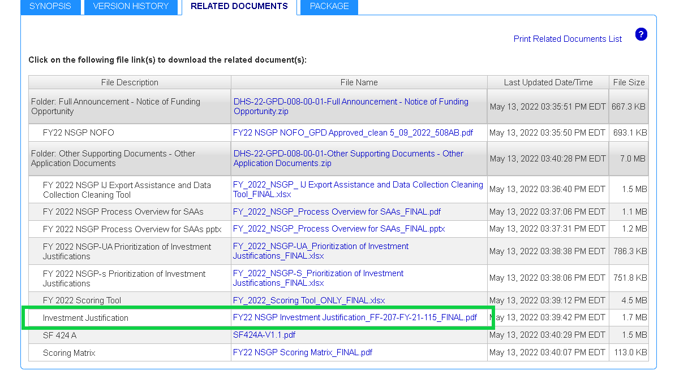

Slide 21
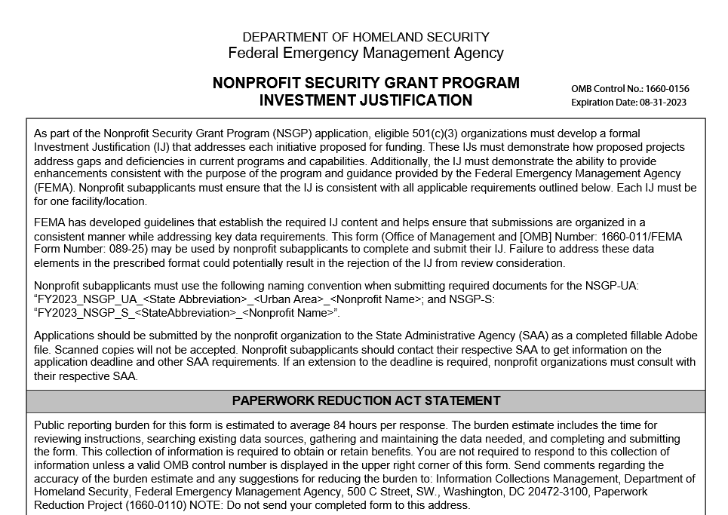

Slide 22
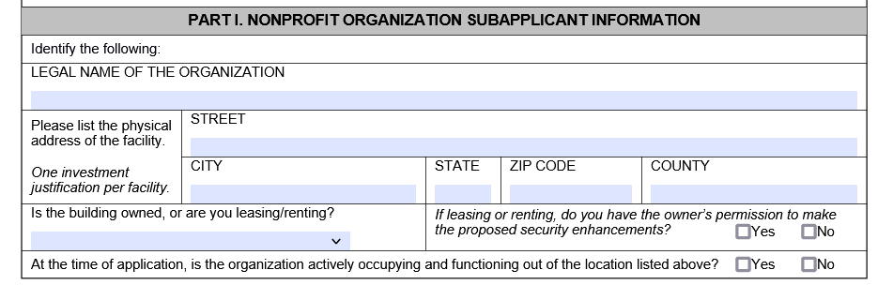

Slide 23
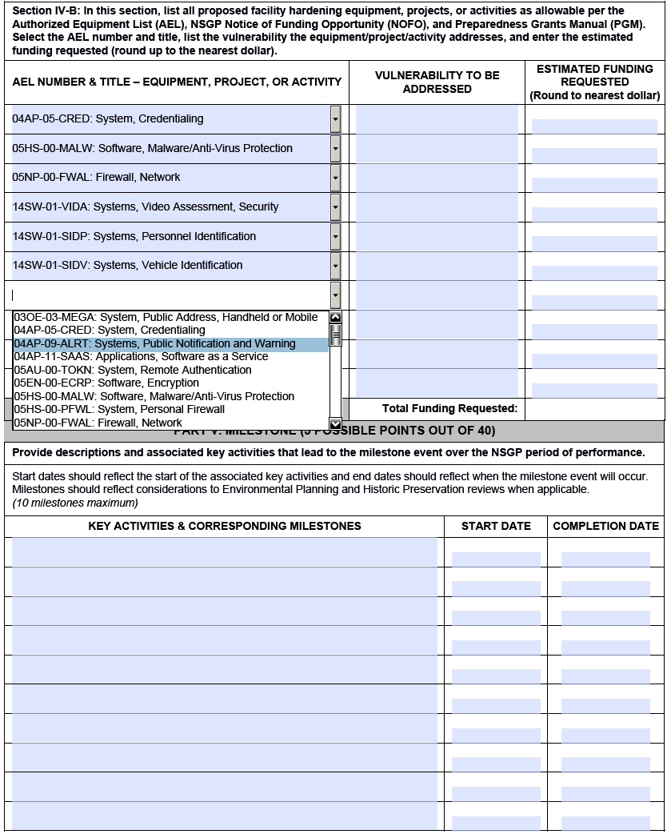

Slide 24
2023 Nonprofit Security Grant Program
INVESTMENT JUSTIFICATION (IJ) REQUIREMENTS
Applicants must use the FEMA Investment Justification Template form.
A Unique Entity Identifier (UEI) number is required information for the IJ Form.
Replaces the Data Universal Numbering System (DUNS), effective April 4, 2022.
OPTIONAL:
Completing/updating the System for Award Management (SAM) Registration should be done as soon as possible, but the information is not entered into the IJ form or submitted to RIEMA.

Slide 25
2023 Nonprofit Security Grant Program
ENVIRONMENTAL & HISTORIC PRESERVATION (EHP)
All DHS grants call for an EHP review. All 2023 awardees will have to complete an EHP review prior to any activities such as:
Facility Construction
Modification/renovation of existing structures
Physical security enhancements to buildings or structures
Construction or Modification of Communication towers
All ground disturbances

Slide 26
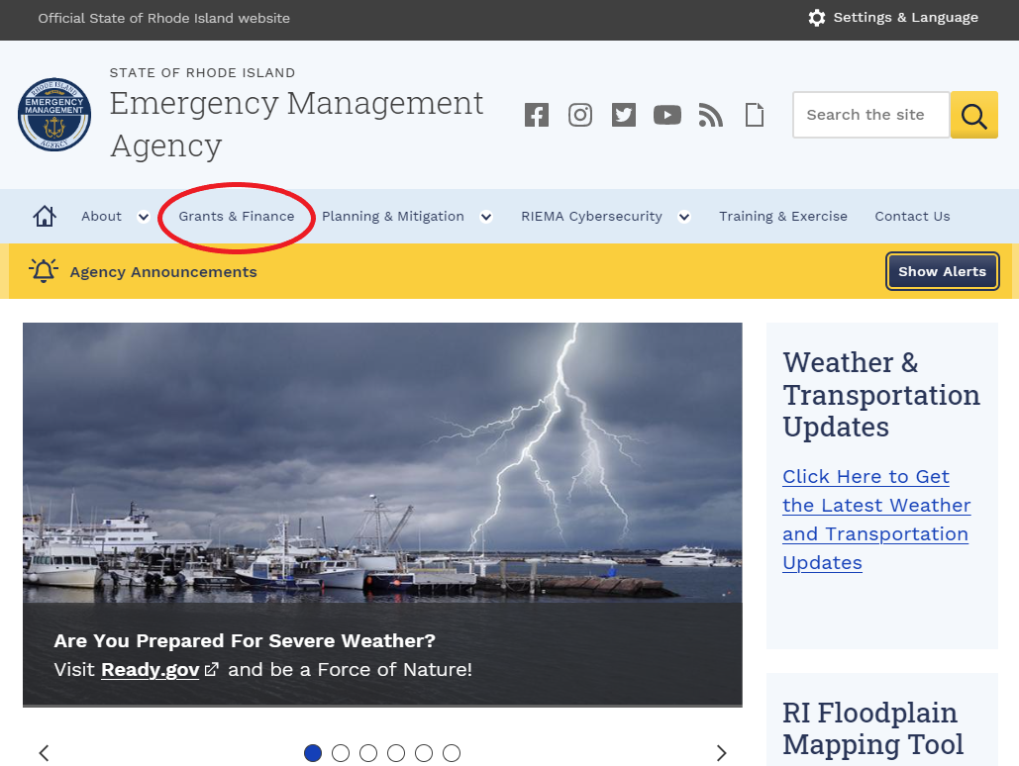

Slide 27
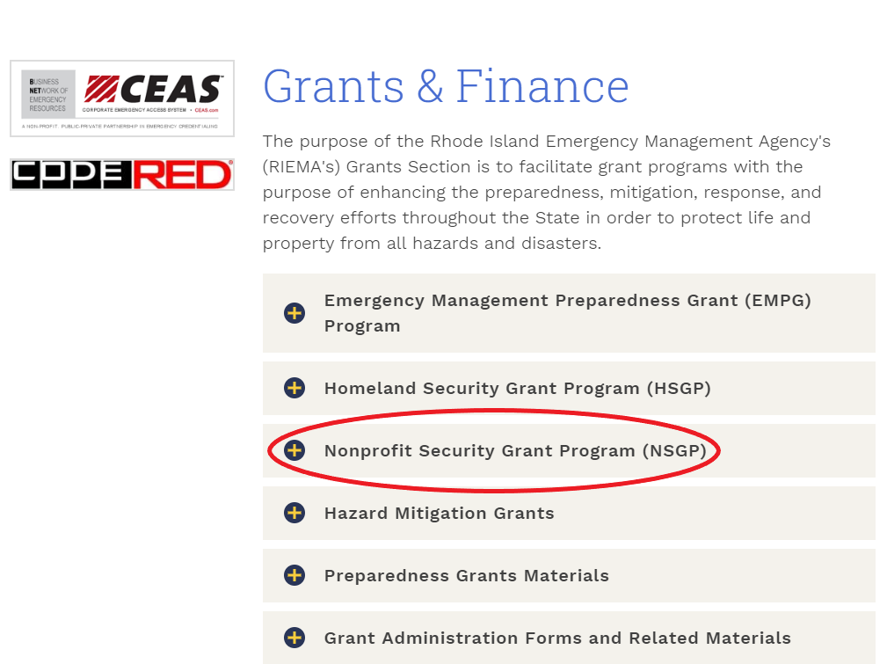

Slide 28
2023 Nonprofit Security Grant Program
Applicants are reminded the following documentation will be needed in order to apply; A completed Investment Justification (IJ); A vulnerability/Threat Assessment unique to the site as related to the IJ; The Mission Statement of the Nonprofit.
Please note you may not alter the Investment Justification Form.
Applicants may want to use Firefox to access the Investment Justification Form. The form is available below or in the eCivis tool for your convenience.
A nonprofit with one site may apply for up to $150,000 for that site. Nonprofits with multiple sites (multiple locations/physical addresses) within Rhode Island may choose to apply for additional sites at up to $150,000 per site for a maximum of three sites, not to exceed $450,000 of funding per nonprofit.
The FY 2023 Application window will be from March 6, 2023, through May 11, 2023, closing at 11:59 PM.

Slide 29
2023 Nonprofit Security Grant Program
To apply for this grant or for more information about grant opportunities in the State, please go to the following link: https://controller.admin.ri.gov/grants-management/state-rhode-island-grant-funding-opportunities
How to apply:
The State of RI has moved to an online portal for grant applications called eCivis. The link to apply is scheduled to be open on March 6, 2023.
Please click on the following link in order to apply: https://gn.ecivis.com/GO/gn_redir/T/fp6abighikcm
Special Note: If you have trouble accessing the Investment Justification Form, please right click on the document below and save to your desktop. You may also have to use an "Open with Adobe" option in order to complete the document. Fill in the required information and then upload into eCivis with your Vulnerability/Threat Assessment and Mission Statement. The Investment Justification Form is below in the files section. As previously noted, applicants may want to use the Firefox browser to access and complete the Investment Justification Form.

Slide 30
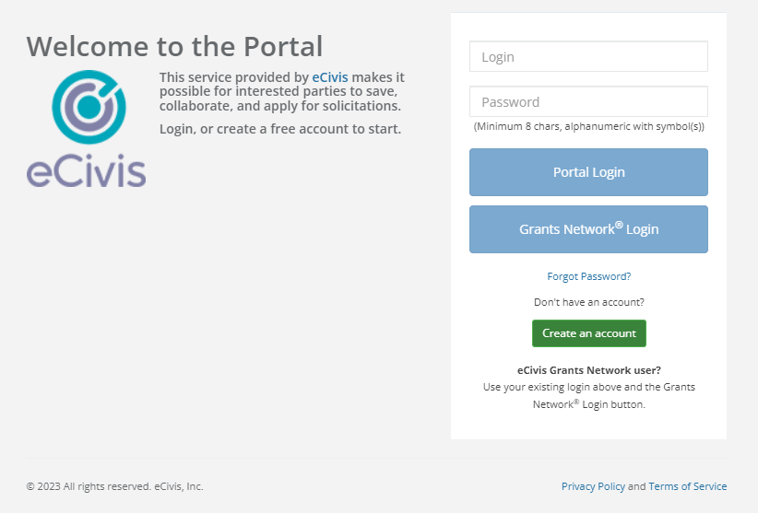
2023 Nonprofit Security Grant Program

Slide 31
2023 Nonprofit Security Grant Program
User Support
Use the link below if you are experiencing technical difficulties, or have questions related to the eCivis Portal and Grants Management System.
Submit a User Support Ticket - Grants Management | Rhode Island (ri.gov)
The Grants Management Office does NOT make grant awards and is unable to respond to requests for funding or financial assistance.

Slide 32
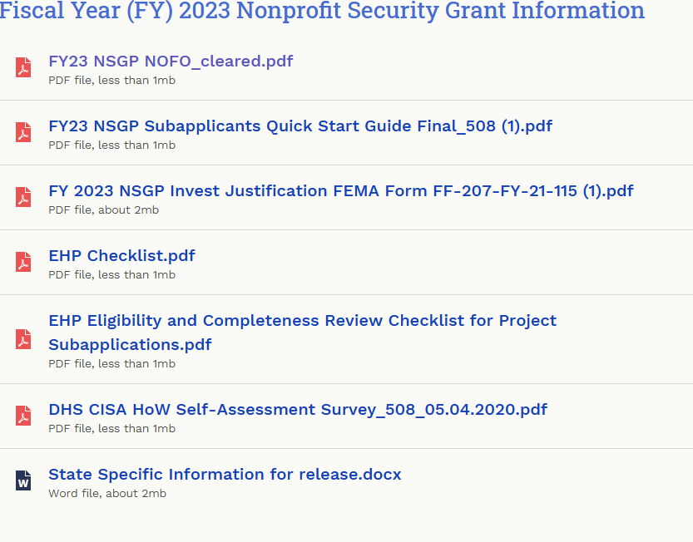

Slide 33
Questions?
RIEMA Grants: EMA.Grants@ema.ri.gov
Twitter: @RhodeIslandEMA
Facebook: facebook.com/rhodeislandema
Web: riema.ri.gov
Instagram: www.instagram.com/rhodeislandema/

