Slide 1
FY 2024 Nonprofit Security Grant Program (NSGP) Roll-Out
May 20, 2024 (2PM-3PM EST)

Slide 2
2024 Nonprofit Security Grant Program
Rhode Island Emergency Management Agency
645 New London Avenue
Cranston, RI 02920
24-hour Phone: (401) 946-9996
Fax: (401) 944-1891
More information may be located at: http://www.riema.ri.gov
Questions may be directed to: ema.grants@ema.ri.gov
Points of Contact:
Rinky Roy-Philip: rinky.royphilip.ctr@ema.ri.gov; 401-462-7535
Denise Manni: denise.manni@ema.ri.gov; 401-462-7028

Slide 3
2024 Nonprofit Security Grant Program
AGENDA
Overview of NSGP
Eligibility
Eligible Applicants At High-Risk of Terror Attack
Funding Guidelines
Key Information
Security Self-Assessment
Sample: Question & Option for Consideration
Priority Areas, Core Capabilities and Lifelines
Allowable & Unallowable Costs
Application Process
Application Excerpts
Reported Application Issue
Investment Justification Requirements
Environmental & Historic Preservation (Post Award)
Site Navigation
Contact Information & Questions

Slide 4
2024 Nonprofit Security Grant Program
OVERVIEW
Nonprofit Security Grant Program (NSGP) is a competitive grant program that provides funding support for facility hardening and other physical security enhancements and activities to nonprofit organizations that are at high-risk of terrorist or extremist attack.
Goal of NSGP is centered on improving and increasing nonprofit organizations physical/cyber security and target hardening to enhance the protection of soft targets/crowded places.
Registered 501(c)(3) entities are eligible for funding to increase security around various facilities though Planning, Organization, Equipment, Training and Exercises (POETE).
NSGP project funding is based on the ability of the proposed project to mitigate the risk factors identified in the Investment justification (IJ). Tax-exempt organizations can be found at: https://www.irs.gov/charities-nonprofits/charitable-organizations
This is a reimbursement-based grant program.
The Rhode Island Emergency Management Agency (RIEMA) is the only entity in Rhode Island (State Administrative Agency-SAA) that may submit FY 2024 NSGP applications (Investment Justifications) directly to the Department of Homeland Security (DHS) / Federal Emergency Management Agency (FEMA).

Slide 5
2024 Nonprofit Security Grant Program
ELIGIBLE NSGP APPLICANTS
Only 501(c)(3) Nonprofit organizations at high-risk of terrorist attack or Extremism.
Applicants must provide proof of 501(c)(3) status or
Provide letter of exemption from IRS/Department of the Treasury.
Applicants must self-identify as one of the following:
Ideology-based/Spiritual/Religious (Houses of Worship)
Educational
Medical
Other (Museums, Clubs, Senior Centers, Community Centers, Day Camps, among many others

Slide 6
2024 Nonprofit Security Grant Program
ELIGIBLE APPLICANTS AT HIGH-RISK OF TERRORIST AND EXTREMIST ATTACK
May include (in application), but is not limited to:
Identification and substantiation of prior threats or attacks by a terrorist organization, network, or cell against the applicant or closely related organizations;
Symbolic value of the site(s) as a highly recognized national or historical institution that renders the site as possible target of terrorism;
Role of the applicant in responding to or recovering from terrorist attacks;
Findings from previously conducted risk assessments including threat or vulnerability, police reports and/or insurance claims.

Slide 7
2024 Nonprofit Security Grant Program
FUNDING GUIDELINES
FY 2024 NSGP allowable costs are focused on security-related activities. Funding can be used for contracted security personnel; security-related planning, exercises, and training ; and the acquisition and installation of security equipment (including improvements) and cybersecurity measures on real property (including buildings) owned or leased by the nonprofit organization at the time of application.
Specifically for prevention of and/or protection against the risk of a terrorist or extremist attack.
The equipment is limited to two categories: Physical Security Enhancement Equipment (AEL Section 14) and Inspection & Screening Systems (AEL Section 15).

Slide 8
2024 Nonprofit Security Grant Program
KEY INFORMATION
Nonprofit organizations must fully answer each question in all the sections of the Investment Justification (s) (IJ), and sub-applicants should summarize the most critically important and impactful information.
The maximum award amount remains at $150,000 per site for up to three sites/addresses, for a potential total of $450,000 per nonprofit organization.
Security Self-Assessment Form (aka Vulnerability Assessment)
Bonus Review Points
Underserved/Disadvantaged Communities
Nonprofit organizations located within a disadvantaged community and demonstrate how they serve a disadvantaged community or population will have up to 10 points added to their project review score. FEMA will apply the Council on Environmental Quality’s Climate and Economic Justice Screening Tool (CEJST) to each sub-applicant using the address of their physical location. FEMA will add 10 points to applications from organizations from organizations in communities identified as “disadvantaged” by CEJST. CEJST Link: https://screeningtool.geoplatform.gov/en/#3/33.47/-97.5
New Recipients
Sub-Applicants that have never received a NSGP award will have 15 points added to their project score.
Notes:
Score Multipliers remain the same:
Total Score x 3 = Final Score (Faith-based Organizations/Houses of Worship)
Total Score x 2 = Final Score (Medical and Educational Institutions)
Total Score x 1 = Final Score (All other entity types)

Slide 9
Security Self-Assessment Form

Slide 10
Security Self-Assessment Form
SAMPLE: Question & Option for Consideration

Slide 11
2024 Nonprofit Security Grant Program
ALLOWABLE COSTS
Management and Administration (M&A) Costs up to 5% of sub-grant award are allowed. (Must include as a line item on application)
Grants Mgmt. training for staff
Equipment and supplies to administer the grant
Internal payroll policies and procedures are subject to review.
Authorized Officials acting as Project Managers cannot attest for own time.
Planning activities related to the development of plans such as Response Plans, Continuity of Operations.
Equipment costs for access control equipment, surveillance, physical protective measures.
Training and Exercises (security-related) costs are allowed.
Allowable training topics: physical security, facility hardening, terrorism awareness/employee preparedness, active shooter.
Maintenance & Sustainment related costs such as maintenance contracts and agreements, warranty coverage, repair or replacement costs, licenses, upgrades, user fees, as defined in DHS/FEMA Policy FP 205-402-125-1.

Slide 12
Allowable Costs -Authorized Equipment List (AEL) & Other
14CI-00-COOP: System, Information Technology Contingency Operations
14EX-00-BCAN: Receptacles, Trash, Blast-Resistant
14EX-00-BSIR: Systems, Building, Blast/Shock/Impact Resistant
14SW-01-ALRM: Systems/Sensors, Alarm
14SW-01-DOOR: Doors and Gates, Impact Resistant
14SW-01-LITE: Lighting, Area, Fixed
14SW-01-PACS: System, Physical Access Control
14SW-01-SIDP: Systems, Personnel Identification
14SW-01-SIDV: Systems, Vehicle Identification
14SW-01-SNSR: Sensors/Alarms, System and Infrastructure Monitoring, Standalone
14SW-01-VIDA: Systems, Video Assessment, Security
14SW-01-WALL: Barriers: Fences; Jersey Walls
15SC-00-PPSS: Systems, Personnel/Package Screening
Code: Contract Security: Private Contract Security Personnel/Guards
Code: M&A: Management and Administration
Planning
Exercise
Notes:
All items on ALLOWABLE COSTS – EQUIPMENT slides can be selected from a dropdown list within the NSGP 2022 application.

Slide 13
Allowable Costs - Authorized Equipment List (AEL) & Other (Cont’d)
03OE-03-MEGA: System, Public Address, Handheld or Mobile
04AP-05-CRED: System, Credentialing
04AP-09-ALRT: Systems, Public Notification and Warning
04AP-11-SAAS: Applications, Software as a Service
05AU-00-TOKN: System, Remote Authentication
05EN-00-ECRP: Software, Encryption
05HS-00-MALW: Software, Malware/Anti-Virus Protection
05HS-00-PFWL: System, Personal Firewall
05NP-00-FWAL: Firewall, Network
05NP-00-IDPS: System, Intrusion Detection/Prevention
06CP-01-PORT: Radio, Portable
06CC-02-PAGE: Services/Systems, Paging
06CP-03-ICOM: Intercom
06CP-03-PRAC: Accessories, Portable Radio
10GE-00-GENR: Generators
13IT-00-ALRT: System, Alert/Notification
21GN-00-INST: Installation
21GN-00-TRNG: Training and Awareness
Notes:
All items on ALLOWABLE COSTS – EQUIPMENT slides can be selected from a dropdown list within the NSGP 2022 application.

Slide 14
Allowable Costs - Authorized Equipment List (AEL) & Other (Cont’d)
New Additions to Allowable Equipment
030E-03-SIGN: Restricted Access and Caution Warning Printable Signs, Traffic Cones, Free Standing Signs, Mountable Signs etc.
06CP-01-RPT: Repeater - Electronic Device that receives a weak or low-level signal and retransmits that signal to extend usable range
10PE-00-UPS: Supply, Uninterruptible Power (UPS) - Systems that compensate for power loss to serviced equipment (for ex. Short duration battery devices)
14SW-01-ASTN: Network, Acoustic Sensor Triangulation

Slide 15
2024 Nonprofit Security Grant Program
UNALLOWABLE COSTS
The following projects and costs are considered ineligible for award consideration:
Organization costs, and operational overtime costs; Organizational operating expenses;
Hiring of public safety personnel;
General-use expenditures;
Overtime and backfill;
Travel costs
Initiatives that do not address the implementation of programs/initiatives to build prevention and protection-focused capabilities directed at identified facilities and/or the surrounding communities;
The development of risk/vulnerability assessment models;
Initiatives that fund risk or vulnerability security assessments or the development of the IJ;
Initiatives in which federal agencies are the beneficiary or that enhance federal property;
Initiatives which study technology development;
Proof-of-concept initiatives;
Initiatives that duplicate capabilities being provided by the Federal Government;
Reimbursement of pre-award security expenses (see Section D.12.b);
Cameras for license plate readers/license plate reader software;
Cameras for facial recognition software;
Weapons or weapons-related training; and
Knox boxes (small wall-mounted safe-holds keys/weapons)

Slide 16
2024 Nonprofit Security Grant Program
APPLICATION PROCESS/PREPARATION
Investment Justification Template (IJ)/(Application) – (Asks nonprofit organizations to describe the organizations risks/threats, and proposed projects/activities to mitigate security deficiencies (as identified in the Vulnerability Assessment) utilizing NSGP funding). Answer questions completely and cannot refer out to any supplemental documents as they are not submitted to nor reviewed by FEMA.
Vulnerability and Risk Assessment – (used to identify and validate physical security deficiencies of organization/facility and is the foundation of an NSGP application) - Submit with the application.
Mission Statement – (a formal summary of the aims and values of an organization; e.g., purpose, values, and goals-documented on official letterhead) Also include in IJ-Submit with the application.
501(c )(3)-proof of nonprofit organization
All complete application packages must be submitted to RIEMA by 5:00 PM on June 14th.
RIEMA submits all applications to the Department of Homeland Security (DHS) for federal review, final scoring and award decisions.
Department of Homeland Security (DHS) makes final award decisions in September of 2024. (official in-person roll-out in Oct 2024-RIEMA HQ)

Slide 17
2024 Nonprofit Security Grant Program
Federal Review
The IJs submitted by each SAA will be reviewed by DHS/FEMA federal staff. Federal staff will also verify that the nonprofit organization is located outside of a FY 2024 UASI-designated high-risk urban area. Federal reviewers will review each IJ to check for the following:
Eligibility (e.g., that a potential subrecipient meets all the criteria for the FY 2024 NSGP NOFO program);
Allowability of the proposed project(s); and
Any derogatory information on the organization applying per Section E.1.d “Security Review.”
Ranking & Prioritization
The SAA will base the ranking on the final scores from the Prioritization Tracker as determined by the SAA’s subject-matter expertise and discretion with consideration of the following factors:
Need: The relative need for the nonprofit organization compared to the other Sub-applicants; and
Impact: The feasibility of the proposed project and how effectively the proposed project addresses the identified need.
The SAA reviewers will score each question in the IJ according to the scoring matrix in Appendix A (Grants Management Handbook)
Final Score Multipliers
To calculate an application’s final score, the sub-applicant's SAA score will be multiplied:
By a factor of three for nonprofit groups that are at a high risk of terrorist or other extremist attacks due to their ideology, beliefs, or mission;
By a factor of two for medical and educational institutions; and
By a factor of one for all other nonprofit organizations.

Slide 18
2024 Nonprofit Security Grant Program
IJ Application Tip:
In preparation to describe how nonprofit organizations intend to use NSGP grant funding, nonprofit organizations should think broadly and holistically in their approach to security measures designed to protect buildings and safeguard people. Some physical security control examples include locks, gates, guards (e.g., contract security).
Although these may be effective measures, there are many additional layers to physical security that can help protect the organization, including creating comprehensive physical security plans, conducting training and exercises (e.g., active shooter, evacuation), identifying countermeasures against intrusion (e.g., access controls), preventing physical security breaches (e.g., security enhanced doors/windows), and monitoring for physical security threats (e.g., cameras, surveillance).
Descriptions of allowable costs and activities can be located in the Notice of Funding (NOFO) and the Preparedness Grants Manual (PGM).

Slide 19
2024 Nonprofit Security Grant Program
FEMA NSGP Application - Troubleshooting
According to www.Grants.gov [grants.gov], you must have the latest version of Adobe Reader and your version of Reader needs to be the same across multiple devices (if using multiple devices).
Additionally, you will need to use the “save as” function to fill out the IJ (application) template when downloading from the RIEMA website. The document must be saved first, and then you can open and fill out the template and then upload into eCivis.
Chrome has been reported as problematic with regards to use. Nonprofits have reported having more success with Firefox and Microsoft Edge.

Slide 20
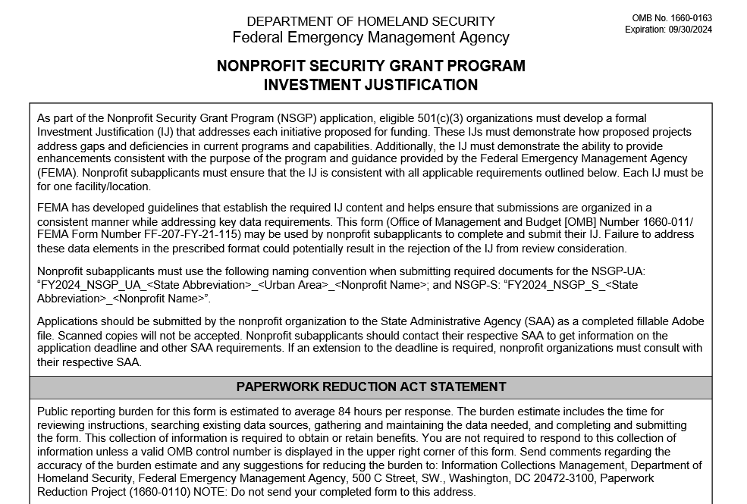

Slide 21
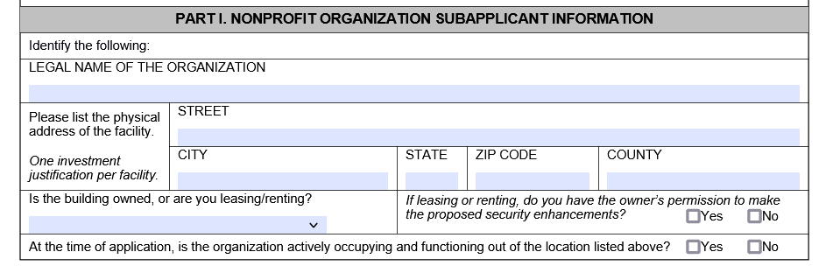

Slide 22
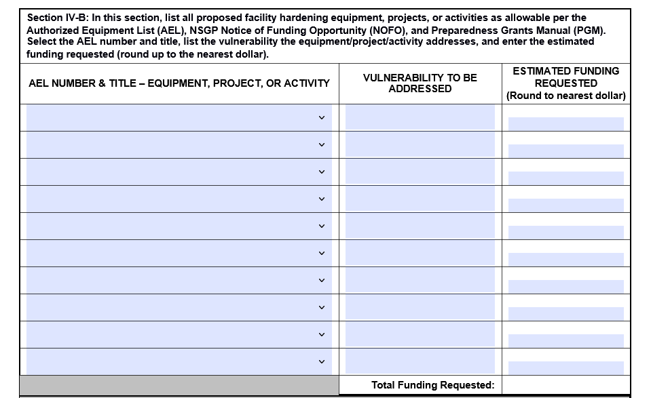

Slide 23
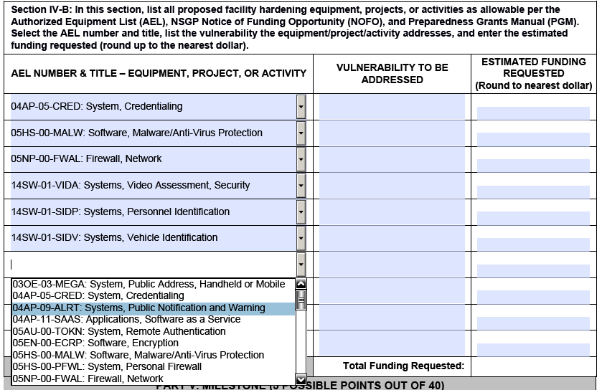

Slide 24
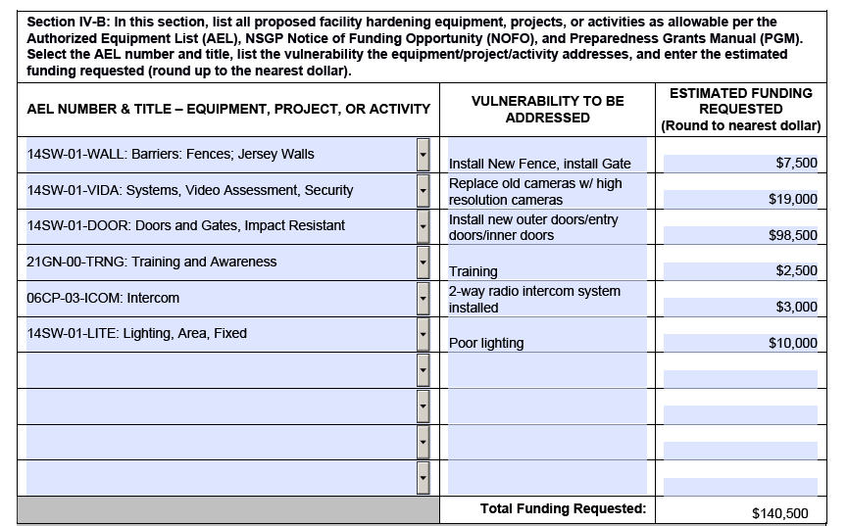
Investment Justification (IJ) Form – AEL Project Examples

Slide 25
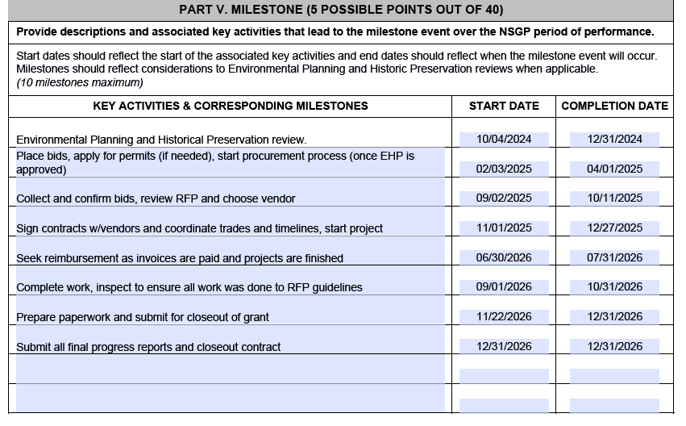
Investment Justification (IJ) Form - Milestone Examples

Slide 26
2024 Nonprofit Security Grant Program
INVESTMENT JUSTIFICATION (IJ) REQUIREMENTS
Applicants must use the FEMA Investment Justification Template form (found on RIEMA website www.riema.ri.gov).
A Unique Entity Identifier (UEI) number is required information for the IJ Form (https://www.sam.gov).Replaces the Data Universal Numbering System (DUNS), effective April 4, 2022.
Must use 2024 IJ
OPTIONAL:
Completing/updating the System for Award Management (SAM) Registration should be done as soon as possible, but the information is not entered into the IJ form or submitted to RIEMA.

Slide 27
2024 Nonprofit Security Grant Program
First-tier subrecipients (meaning entities receiving funds directly from the recipient) are only required to obtain a UEI through SAM, but they are not required to complete the full SAM registration to obtain a UEI. Recipients (RIEMA) may not make subawards unless the subrecipient (Nonprofit Organizations) has obtained and provided the UEI.
To verify that your organization is properly registered in SAM’s go to: https://www.sam.gov. Entities that create a private profile for the UEI in SAM will need to send a copy of the active UEI to RIEMA.

Slide 28
2024 Nonprofit Security Grant Program
ENVIRONMENTAL & HISTORIC PRESERVATION (EHP)
All DHS grants call for an EHP review (Post Award). All 2024 awardees will have to complete an EHP review prior to any project (The EHP review process involves the submission of a detailed project description via a screening form along with any supporting documentation requested by FEMA) activity such as:
Facility Hardening
Modification/Renovation of existing structures
Physical Security Enhancements to buildings or structures
All ground disturbances

Slide 29
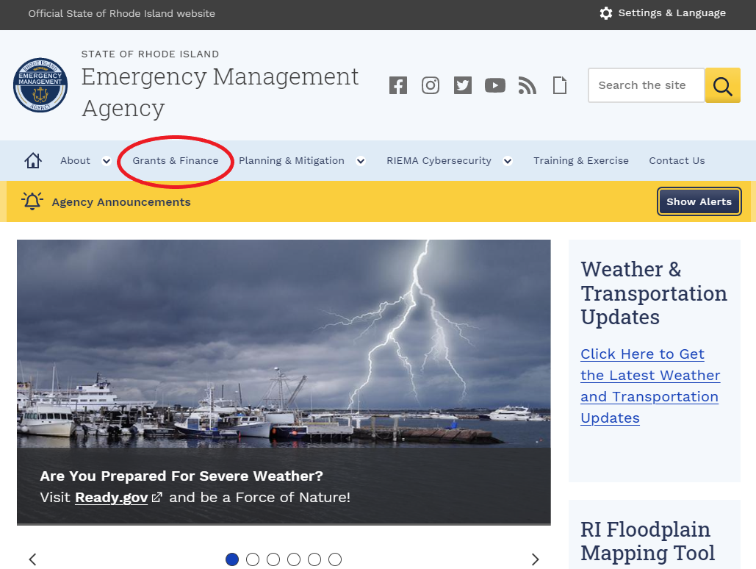

Slide 30
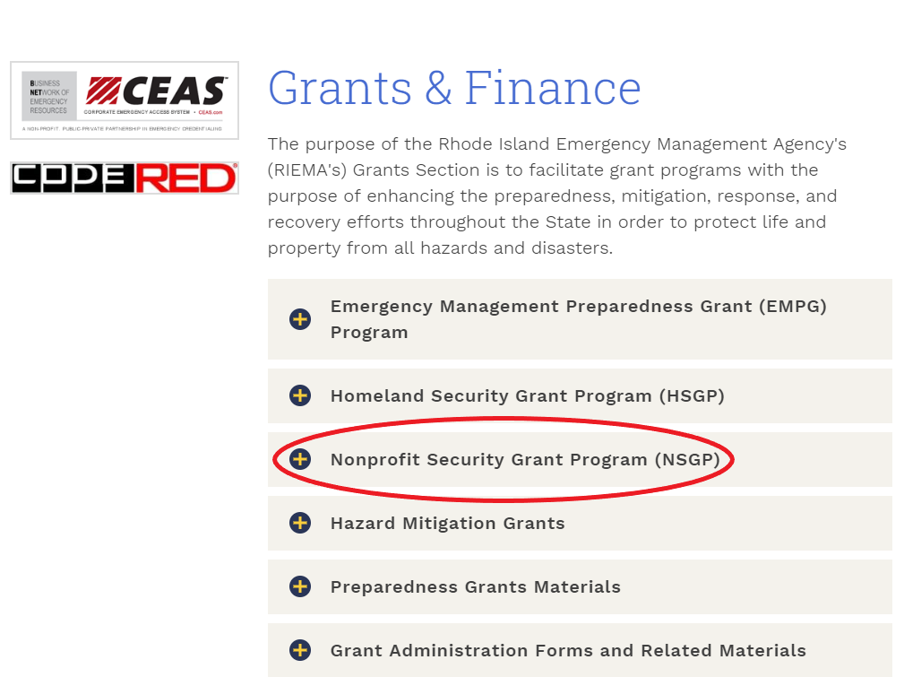

Slide 31
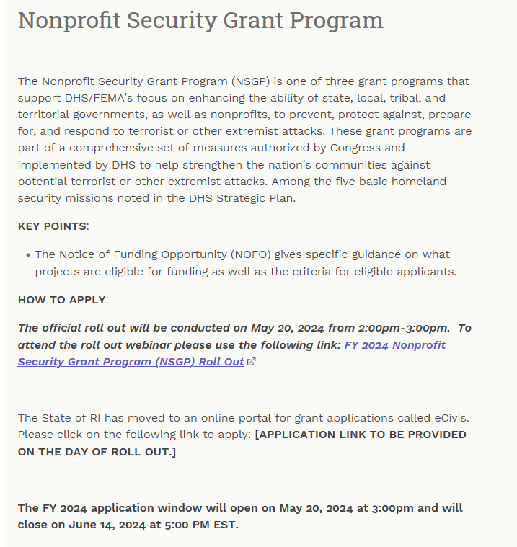
2024 Nonprofit Security Grant Program
www.riema.ri.gov

Slide 32
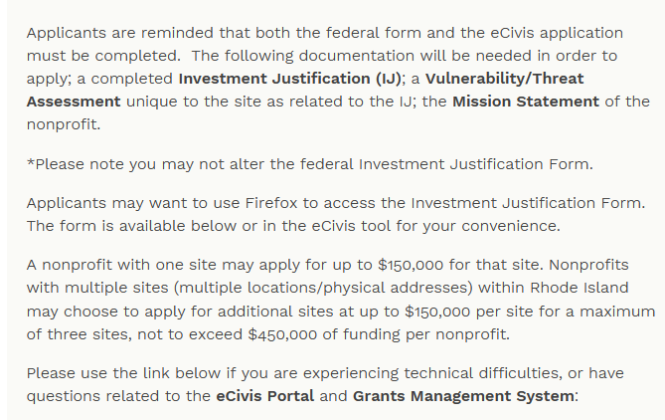
2024 Nonprofit Security Grant Program
www.riema.ri.gov

Slide 33
2024 Nonprofit Security Grant Program
Applicants are reminded the following documentation will be needed in order to apply; A completed Investment Justification (IJ); A vulnerability/Threat Assessment unique to the site as related to the IJ; The Mission Statement of the Nonprofit.
Please note you may not alter the Investment Justification Form.
Applicants may want to use Firefox to access the Investment Justification Form. The form is available in the eCivis tool for your convenience.
A nonprofit with one site may apply for up to $150,000 for that site. Nonprofits with multiple sites (multiple locations/physical addresses) within Rhode Island may choose to apply for additional sites at up to $150,000 per site for a maximum of three sites, not to exceed $450,000 of funding per nonprofit.

Slide 34
2024 Nonprofit Security Grant Program
HOW TO APPLY for NSGP FY24:
The State of RI has moved to an online portal for grant applications called eCivis. The link to apply is scheduled to be open on May 20, 2024.
Please click on the following link in order to apply: https://gn.ecivis.com/GO/gn_redir/T/477rje1yv4oy
Special Note: If you have trouble accessing the Investment Justification Form, please right click on the document and save to your desktop. You may also have to use an "Open with Adobe" option in order to complete the document. Fill in the required information and then upload into eCivis with your Vulnerability/Threat Assessment, Mission Statement and 501C3 proof. The Investment Justification Form is on the RIEMA website www.riema.ri.gov in the files section. As previously noted, applicants may want to use the Firefox browser to access and complete the Investment Justification Form.
All applications from eligible nonprofits within the state for FY 2024 NSGP funding must NOT be submitted to RIEMA (EMA.Grants@ema.ri.gov).

Slide 35
2024 Nonprofit Security Grant Program

Slide 36
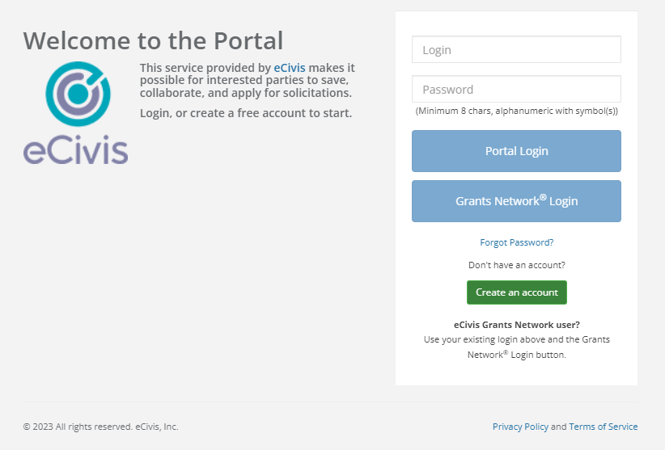
2024 Nonprofit Security Grant Program

Slide 37
2024 Nonprofit Security Grant Program
USER SUPPORT
Use the link below if you are experiencing technical difficulties, or have questions related to the eCivis Portal and Grants Management System.
Submit a User Support Ticket - Grants Management | Rhode Island (ri.gov)
The Grants Management Office does NOT make grant awards and is unable to respond to requests for funding or financial assistance.

Slide 38
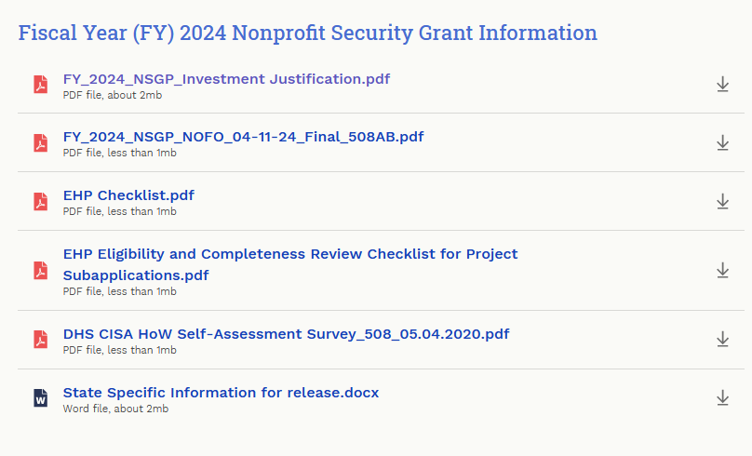
2024 Nonprofit Security Grant Program

Slide 39
QUESTIONS?
RIEMA Grants Email: EMA.Grants@ema.ri.gov
X: https://x.com/RhodeIslandEMA
Facebook: www.facebook.com/rhodeislandema
Web: www.riema.ri.gov
Instagram: www.instagram.com/rhodeislandema/
For more information about grant opportunities in the State, please go to the following link: https://controller.admin.ri.gov/grants-management/state-rhode-island-grant-funding-opportunities

