Slide 1
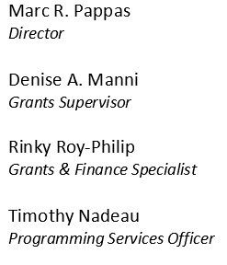
FY 2024 DHS / FEMA Homeland Security Grant Program Roll Out Webinar
Date: July 24, 2024, 10-11:30AM

Slide 2
FY 2024 Homeland Security Grant Program (HSGP)
Agenda
FY 2024 HSGP Overview
DHS Requirements
Projects to be Considered
Application Process Milestones
Application Process Timeline
How to Apply
Post-Award Requirements
Environmental and Historical Preservation (EHP)
Grant Administration
National Cyber Security Review (NCSR)
Reminders
Questions
Contact Information
2

Slide 3
FY 2024 Homeland Security Grant Program (HSGP)
FY 2024 HSGP Overview
To build, sustain, and deliver core capabilities to achieve the National Preparedness Goal of a secure and resilient Nation.
Gaps are identified during the Threat and Hazard Identification and Risk Assessment (THIRA) process and assessed in the State Preparedness Report (SPR).
Funding sustains current capability levels and fills identified gaps in Planning, Organization, Equipment, Training, and Exercise activities in order to prevent, protect against, mitigate, respond to, and recover from acts of terrorism or catastrophic events.
The Non-Disaster Grant program related to this roll-out is the Homeland Security Grant Program (HSGP) also sometimes known as “SHSP.”
3

Slide 4
FY 2024 Homeland Security Grant Program (HSGP)
DHS Requirements
The Department of Homeland Security continues to mandate certain projects be funded according to National Priorities. For this year, the following priorities will be addressed with statutory funding:
Enhancing the protection of Soft Targets/Crowded Places
(e.g. Deployable Message Board/Camera Trailer)
Enhancing Information & Intelligence Sharing and analysis
Combating Domestic Violent Extremism
Enhancing Cybersecurity
Cybersecurity projects are also funded under SLCGP funding.
Enhancing Election Security
Enhancing Community Resilience
(e.g. CERT)
4

Slide 5
Projects to be Considered
FY 2024 Homeland Security Grant Program (HSGP)
80% of program funding is invested to support efforts such as Cyber, Fusion Center, Regional Teams, Interoperable Communications, Radiological, CBRNE/WMD, HAZMAT, Exercise, Soft Target Protection, Public Information and Awareness.
Eligible THIRA related projects:
RISCON Communications Projects directly related to the system.
Note: RIEMA will not fund handheld portable radios.
Community Preparedness and Resilience (CERT)
Soft Target/Crowded Places - Notification/Messaging/Camera Trailer
Preparedness Supplies/Equipment
Planning, Trainings or Exercises
No construction will be considered by RIEMA
No Cost Share / No Match Required
5
Notes:
For all municipal cybersecurity related projects, please apply under the upcoming SLCGP 2023 funding opportunity.

Slide 6
Application Process Milestones
FY 2024 Homeland Security Grant Program (HSGP)
Application Start: July 31, 2024
Applications Due: August 30, 2024
Applicants Notified of Grant Determination:
No Later than September 30, 2024
Period of Performance Start:
October 1, 2024
Period of Performance End:
August 31, 2027
POP End Dates may vary depending upon the nature and scope of projects.
6

Slide 7
Application Process Timeline
FY 2024 Homeland Security Grant Program (HSGP)
July 24, 2024
RIEMA hosts conference call with State and Local partners announcing process for prescreening.
PowerPoint to be placed on RIEMA website after brief.
July 31, 2024
RIEMA opens application form in portal. Applicants begin creating accounts in the GMS/eCivis system.
RIEMA begins collecting applications for review
Preparation
RIEMA applies for the HSGP Program through grants.gov. no later than
June 24, 2024.
7

Slide 8
Application Process Timeline (cont’d)
FY 2024 Homeland Security Grant Program (HSGP)
August 30, 2024
RIEMA closes application portal.
September 2, 2024 –
September 30, 2024
RIEMA reviews applications and selects projects to be funded.
*If necessary, RIEMA may also issue requests for information during the funding determination process.
July 31, 2024 –
August 30, 2024
RIEMA accepts formal applications (POETE model) through the GMS/eCivis portal.
September 20, 2024 – September 30, 2024
RIEMA begins award process.
October 1, 2024
Award letters with related grant packages are sent to sub-recipients.
8

Slide 9
How to Apply
FY 2024 Homeland Security Grant Program (HSGP)
RIEMA is using a portal system for grant applications accessible through the RIEMA website located at: www.riema.ri.gov
Multiple projects require multiple applications:
e.g. Local CERT team funding using HSGP would require its own application while an application for a message board trailer would need one as well.
This process is similar to the Department of Homeland Security’s application process for States.
9

Slide 10
How To Apply - Site Navigation
10

Slide 11
How To Apply - Site Navigation
11

Slide 12
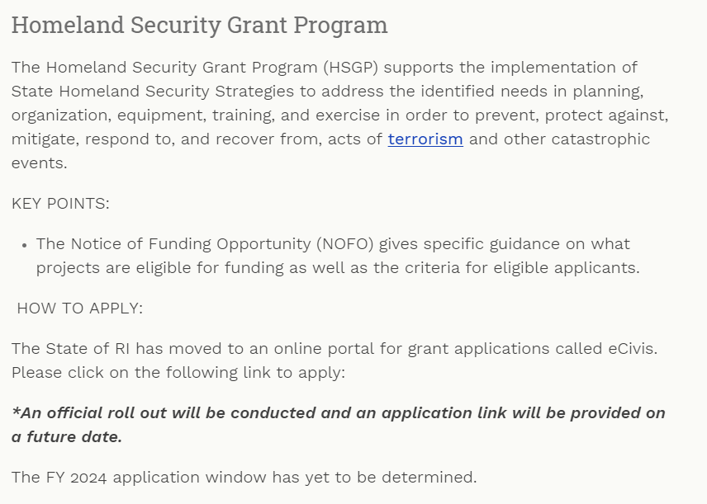
FY 2024 Homeland Security Grant Program (HSGP)
12

Slide 13
FY 2024 Homeland Security Grant Program (HSGP)
13

Slide 14
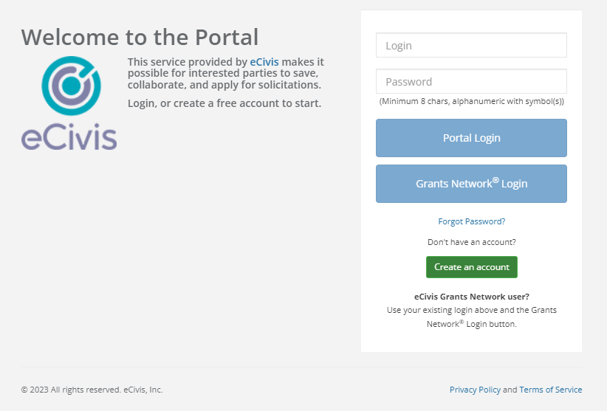
FY 2024 Homeland Security Grant Program (HSGP)
Create an account if your organization is new to the system.
14

Slide 15
FY 2024 Homeland Security Grant Program (HSGP)
USER SUPPORT
Use the link below if you are experiencing technical difficulties, or have questions related to the eCivis Portal and Grants Management System.
Submit a User Support Ticket - Grants Management | Rhode Island (ri.gov)
The Grants Management Office does NOT make grant awards and is unable to respond to requests for funding or financial assistance. Please contact RIEMA for any programmatic issues related to grant programs.
15

Slide 16
How to Apply (cont’d)
FY 2024 Homeland Security Grant Program (HSGP)
Applicants must apply for each project. Each project must have a budget figure(s) included. All fields need to be completed in order to submit. No applications will be accepted after the portal closes. Applicants are limited to three (3) project applications for submission.
A review process will be used to evaluate projects that fit into the State Emergency Management Strategy.
Applicants are required to be registered in the System for Award Management (SAM) and have an active Unique Entity Identifier (UEI), formerly known as a Data Universal Numbering System (DUNS) number. Please contact your city controller to determine the correct municipal UEI number to use.
To ascertain whether or not your city is properly registered in SAM’s go to: https://www.sam.gov
16

Slide 17
How to Apply (cont’d)
FY 2024 Homeland Security Grant Program (HSGP)
All applicants will receive a notification of determination. Your notification may place requirements on your application, e.g. more information is needed concerning your project or you may be required to provide more milestones. The notification may also include an obligation/declination of award. The application process includes:
POETE allocations
Budget projection
Goals/ Milestones
Note: Please include 4 milestones in the application.
Project implementation
Project Management requirements
17

Slide 18
Environmental and Historic Preservation (EHP)
Post-Award Requirements
DHS/FEMA is required to consider the effects of its actions on the environment and/or historic properties:
Including, but not limited to, construction of communication towers, modification or renovation of existing buildings, structures and facilities, or new construction including replacement of facilities.
Involves the submission of a detailed project description that explains the goals and objectives of the proposed project along with supporting documentation.
Documentation required includes GPS coordinates, ground level photographs, overhead imaging that includes all adjacent properties (screenshot from web-based map), and detailed drawings. All interior/exterior images must be labelled to provide reviewers clarity on worksite locations.
Any project with construction or installation related work must undergo EHP review – from mounting television monitors on walls to installation of a generator.
18

Slide 19
Grant Administration
Post-Award Requirements (cont’d)
New requirements when purchasing technical items (Prohibitions on Expending FEMA Award Funds for Covered Telecommunications Equipment or Services).
Nationwide Cyber Security Review (NCSR) – still applicable: Confirmation will be due to RIEMA by December 16, 2024. Failure to comply with the NCSR requirements may result in termination of the entire grant agreement.
Cybersecurity Assessment – ongoing requirement - FY 2024 recipients and subrecipients will be required to complete the NCSR, which is open annually from October to December, by the end of calendar year 2024 in order for agencies to benchmark and measure progress of improving their cybersecurity posture. The Chief Information Officer (CIO), Chief Information Security Officer (CISO), or equivalent for each recipient and subrecipient should complete the NCSR. If there is no CIO or CISO, the most senior cybersecurity professional should complete the assessment.
Quarterly reports need to be submitted timely within the GMS portal.
19

Slide 20
REMINDERS
FY 2024 Homeland Security Grant Program (HSGP)
Program received a 9% reduction in funding for FY 2024.
Not all projects can be funded.
Consider project eligibility
Consider reasonability of costs
Partially-funded projects will not be considered.
Construction projects will not be funded.
Please submit your Nationwide Cyber Security Review (NCSR) as soon as possible.
20

Slide 21
Questions?
RIEMA Grants Email: ema.grants@ema.ri.gov
Website: www.riema.ri.gov
X: https://x.com/RhodeIslandEMA
Facebook: www.facebook.com/rhodeislandema
Instagram: www.instagram.com/rhodeislandema/
For more information about grant opportunities in the State, please go to the following link: https://controller.admin.ri.gov/grants-management/state-rhode-island-grant-funding-opportunities
21

Slide 22
FY 2024 Preparedness Grant Programs
Rhode Island Emergency Management Agency
645 New London Avenue
Cranston, RI 02920
Phone: (401) 946-9996
Fax: (401) 944-1891
More information may be located at: http://www.riema.ri.gov
Questions may be directed to: ema.grants@ema.ri.gov
Points of Contact:
Denise Manni: denise.manni@ema.ri.gov; 401-462-7028
Tim Nadeau: timothy.nadeau@ema.ri.gov; 401-462-7535
Rinky M. Roy-Philip: rinky.royphilip.ctr@ema.ri.gov; 401-318-0962
22

