Slide 1
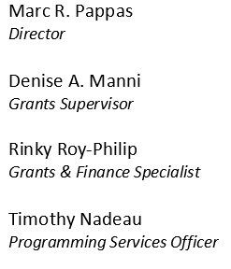
FY 2024 Emergency Preparedness Grant Program (EMPG)Roll-Out
Date: July 24, 2024, 10-11:30AM

Slide 2
2024 Preparedness Grant Programs
Agenda
EMPG Overview
Requirements
EMPG Notes
How to Apply
Environmental and Historical Preservation (EHP)
Grant Administration
Reminders
Questions and Answers
Contact Information
2

Slide 3
2024 Preparedness Grant Programs
EMPG Grant Overview
To assist local units of government in building, sustaining, and delivering a whole community emergency management program.
EMPG funding result of the Stafford Act
State-wide gaps are identified during the Threat and Hazard Identification and Risk Assessment (THIRA) process and assessed in the State Preparedness Report (SPR).
Funding sustains current capability levels and fills identified gaps in Planning, Organization, Equipment, Training, and Exercise activities in order to prevent, protect against, mitigate, respond to, and recover from acts of terrorism or catastrophic events.
3

Slide 4
2024 Preparedness Grant Programs
EMPG Grant Overview (continued)
These funds are used as pass-through funding for the State, Local, and Tribal Assistance (SLA) program:
Used to support local emergency management efforts including personnel, EOCs, communications, and local emergency management capability enhancement.
EMPG funding has a cost share (match) of 50%.
RIEMA requires cash (hard match) for EMPG sub-awards and will not accept In-Kind (soft match) costs.
4

Slide 5
2024 Preparedness Grant Programs
EMPG Requirements
All EMPG funded personnel shall complete either the Independent Study courses identified in the Professional Development Series (PDS) or attend the National Emergency Management Basic Academy (NEMBA) delivered either by the Emergency Management Institute (EMI) or at a sponsored state, local, tribal, territorial, regional or other designated location.
5

Slide 6
PDS vs. NEMBA
Professional Development Series
Independent Study (IS)
National Emergency Management
Basic Academy (NEMBA)
IS-100: Intro to the Incident Command System (ICS)
IS-200: Basic Incident Command System for Initial Response
IS-700: Intro to the National Incident Management System
IS-800: Intro to National Response Framework
IS-120: An Introduction to Exercises
IS-230: Fundamentals of Emergency Management
IS-235: Emergency Planning
IS-240: Leadership and Influence
IS-241: Decision Making and Problem Solving
IS-242: Effective Communication
IS-244: Developing and Managing Volunteers
IS-100: Intro to the Incident Command System (ICS)
IS-200: Basic Incident Command System for Initial Response
IS-700: Intro to the National Incident Management System
IS-800: Intro to National Response Framework
IS-29: Public Information Officer Awareness (prerequisite for E/L0105)
IS-230: Fundamentals of Emergency Management
E/L0101: Foundations of Emergency Management
E/L0102: Science of Disaster
E/L0103: Planning – Emergency Operations
E/L0104: Exercise Design
E/L0105: Public Information Basics
E/L/K0146: Homeland Security Exercise & Evaluation (HSEEP) Training
-OR-
6

Slide 7
2024 Preparedness Grant Programs
EMPG Requirements
Must have a current Hazard Mitigation Plan or complete a plan and submit to RIEMA no later than October 1, 2024.
Participate in two State Emergency Operations Center trainings during the grant period of performance.
RIEMA will post information on when trainings will take place on the RIEMA website.
RIEMA will also email EMD’s relative to the trainings.
Maintain access and reporting within the RIEMA WebEOC tool.
Login to WebEOC at least once per quarter.
Maintain Activity logs as appropriate during activations
Maintain contact information for your jurisdiction.
7

Slide 8
2024 Preparedness Grant Programs
EMPG FY 2024 Notes
Salary expenses must be matched through municipal funds depicted in a budget document, line item in the budget, or similar document.
For personnel fulfilling a dual role, the organization must demonstrate the ability to identify the difference between non-EMA and EMA duties/costs
Third party or “in-kind” match must be outlined in the application and pre-approved by RIEMA prior to award; in-kind cannot be used as salary, planning, or equipment match
Construction projects will not be considered during this round of grant award funding.
Prior to a grant award being issued, perspective sub-recipients will have to submit the personnel/positions to be funded and certification that the required courses, under the EMPG program, are completed.
8

Slide 9
2024 Preparedness Grant Programs
EMPG Projects for Consideration
The RIEMA EMPG program is directed at local units of government in order to maintain and sustain an active Emergency Management Preparedness posture.
Projects include:
Funding for personnel such as the EMA Director or EMA staff for a local Emergency Management program
Sustainment of the program involving day to day expenses
Community Emergency Response Team (CERT) establishment, sustainment, and training;
Allowable costs also include Interoperable Communications Equipment; Interoperable Communications Plans; EOC Equipment; Evacuation route plans;
Limited Equipment per Authorized Equipment List – Equipment may not be third party/in-kind matched
NEW: Costs associated with position-specific training needs related to National Qualification System (NQS) requirements.
NEW: Costs associated with the certification/recertification of instructors.
9

Slide 10
2024 Preparedness Grant Programs
Projects for consideration need to meet RIEMA’s vision for a well-prepared whole community participation in planning, response, recovery and mitigation through addressing state priorities.
More information about the State EMPG allocations may be found on the RIEMA website located at: www.riema.ri.gov including the Notice of Funding Opportunity (NOFO)
10

Slide 11
Application Process Milestones
2024 Preparedness Grant Programs
Application Start: July 31,2024
Applications Due: August 30, 2024
Applicants Notified of Grant Determination:
No Later than September 30, 2024
Period of Performance Start:
October 1, 2024
Period of Performance End:
September 30, 2026
POP End Dates may vary depending upon the nature and scope of projects.
11

Slide 12
How to Apply
RIEMA is using an online system for grant applications accessible through the RIEMA website located at: www.riema.ri.gov
Once you access the RIEMA website, click on the Grants Finance Section and scroll down to the EMPG Grant banner in order to apply for EMPG.
Multiple projects require multiple applications, E.g., Local CERT team funding using EMPG would require an application, while a local EMA Directors salary requires an additional EMPG application.
12

Slide 13
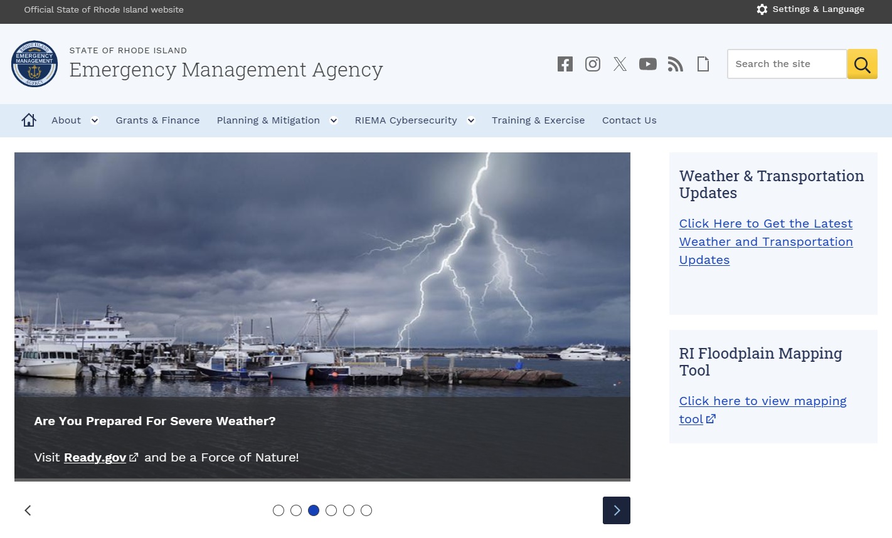
How to Apply
13

Slide 14
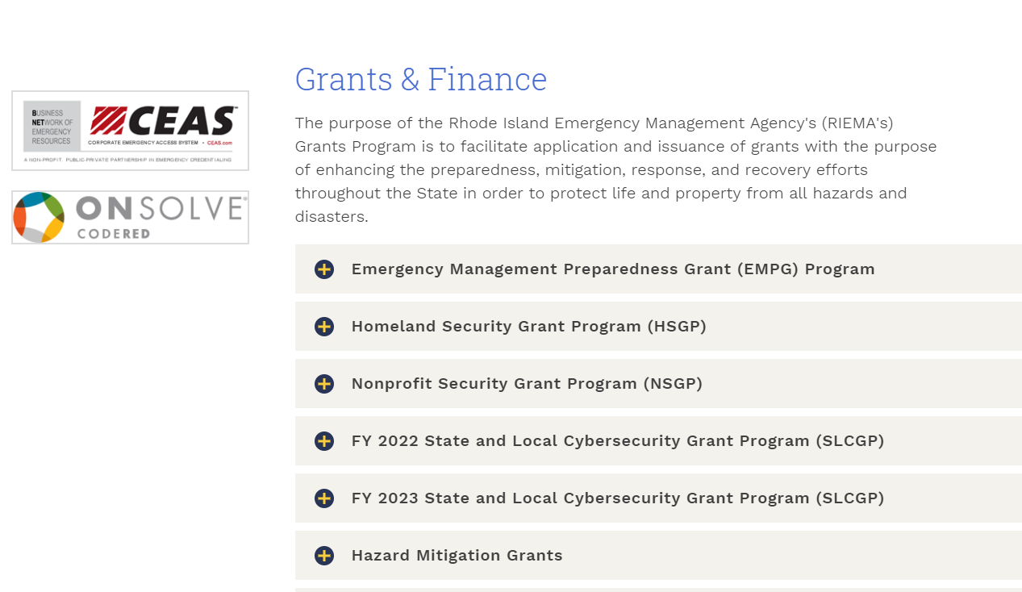
How to Apply – Site Navigation
14

Slide 15
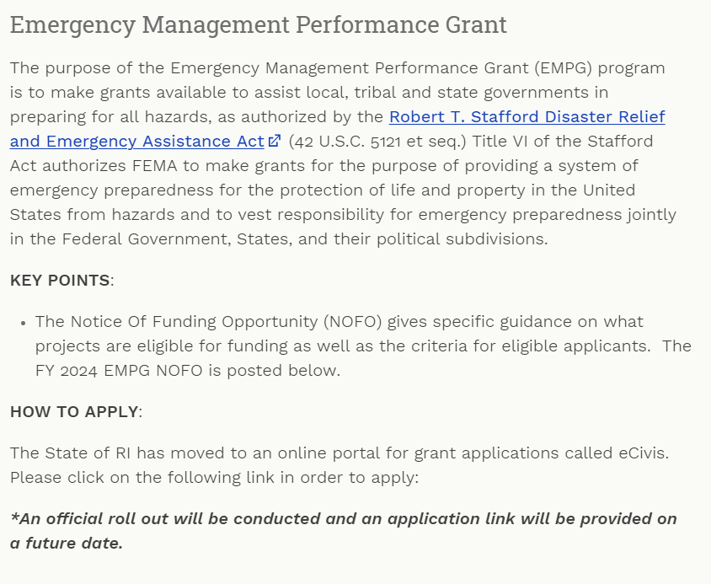
How to Apply (cont’d)
15

Slide 16
How to Apply (cont’d)
16

Slide 17
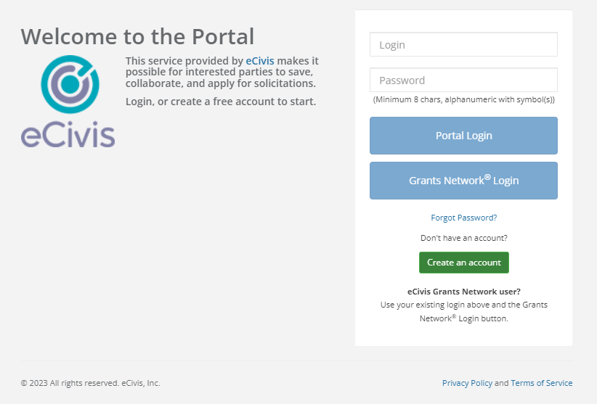
2024 Preparedness Grant Programs
Create an account if your organization is new to the system.
17

Slide 18
2024 Preparedness Grant Programs
USER SUPPORT
Use the link below if you are experiencing technical difficulties, or have questions related to the eCivis Portal and Grants Management System.
Submit a User Support Ticket - Grants Management | Rhode Island (ri.gov)
The Grants Management Office does NOT make grant awards and is unable to respond to requests for funding or financial assistance. Please contact RIEMA for any programmatic issues related to grant programs.
18

Slide 19
How to Apply (cont’d)
Applicants must apply online at www.riema.ri.gov. An application is due for each project. Each project must have a budget figure(s) included. All fields need to be completed in order to submit. No applications will be accepted after the portal closes. Applicants are limited to three (3) projects.
Applicants will require being registered in the System for Award Management (SAM’s) and use of your local Unique Entity Identifier (UEI)/ formerly known as a Data Universal Numbering System (DUNS) number – please contact your city controller to determine the correct municipal UEI number to use.
To ascertain whether or not your city is properly registered in SAM’s go to: https://www.sam.gov. Entities that create a private profile for the UEI in SAM will need to send a copy of the active UEI to RIEMA.
19

Slide 20
How to Apply (cont’d)
Subsequent notification from RIEMA may place requirements on your application or you may be required to provide more milestones. The application process includes:
POETE
Budget
Goals/ Milestones – note please include 4 milestones in the application
Project implementation
Project Management requirements
Assurance forms, to include EHP information and other requirements
Project is related to RIEMA program guidance
20

Slide 21
2024 Preparedness Grant Programs
Environmental and Historic Preservation (EHP)
DHS/FEMA is required to consider the effects of its actions on the environment and/or historic properties:
Including but not limited to construction of communication towers, modification or renovation of existing buildings, structures and facilities, or new construction including replacement of facilities.
Involves the submission of a detailed project description that explains the goals and objectives of the proposed project along with supporting documentation.
Documentation required includes GPS coordinates, ground level and overhead photographs (screenshot from web-based map program), and detailed drawings.
21

Slide 22
REMINDERS
Program received a 9% reduction in funding for FY 2024.
Resources are limited, prudent/allowable funding requests are a priority.
Not all projects can be funded.
Past funding does not guarantee future funding.
If the funding disappears next cycle, what is your sustainment plan?
Ensure that your application for funding aligns with the guidance.
Submit reimbursement requests in a timely fashion; funding may be swept once the period of performance has ended.
22

Slide 23
REMINDERS (cont’d)
Readiness: Begins at the local level and ends at the local level.
FEMA Requirements:
NIMS Training
Shall complete either the Independent Study courses identified in the Professional Development Series or the National Emergency Management Basic Academy
State Requirements EMPG:
Maintain NIMS Compliance for the community
Maintain WebEOC username and password; monthly log-in ;
Other requirements may apply
EMPG Match: 50/50
23

Slide 24
Questions?
RIEMA Grants Email: ema.grants@ema.ri.gov
Website: www.riema.ri.gov
X: https://x.com/RhodeIslandEMA
Facebook: www.facebook.com/rhodeislandema
Instagram: www.instagram.com/rhodeislandema/
For more information about grant opportunities in the State, please go to the following link: https://controller.admin.ri.gov/grants-management/state-rhode-island-grant-funding-opportunities
24

Slide 25
2024 Non-Disaster Grant Programs
Rhode Island Emergency Management Agency
645 New London Avenue
Cranston, RI 02920
24-hour Phone: (401) 946-9996
Fax: (401) 944-1891
More information may be located at: http://www.riema.ri.gov
Questions may be directed to: ema.grants@ema.ri.gov
Other Points of Contact:
Denise A. Manni: denise.manni@ema.ri.gov; 401-462-7028
Tim Nadeau: timothy.nadeau@ema.ri.gov; 401-462-7535
Rinky M. Roy-Philip: rinky.royphilip.ctr@ema.ri.gov; 401-318-0962
25

