Slide 1


FY 2025 Emergency
Preparedness Grant Program (EMPG) Roll-Out
Date: June 10, 2026

Slide 2
2025 EMPG Grant Overview
AGENDA
EMPG Overview
Requirements
Professional Development
Allowable/Unallowable Costs
Grant Access Information
Contact Information
Q & A
2

Slide 3
2025 EMPG Grant Overview
REQUIREMENTS
Maintains focus on all-hazards emergency preparedness including evolving threats and risks associated with natural disasters.
EMPG funding result of the Stafford Act
State-wide gaps are identified during the Threat and Hazard Identification and Risk Assessment (THIRA) process and assessed in the State Preparedness Report (SPR).
Funding sustains current capability levels and fills identified gaps to support the emergency management needs of state, local, tribal, and territorial governments, primarily through investments in planning, training, and exercise activities and to help cover the salaries of emergency management personnel.
3

Slide 4
2025 EMPG Grant Overview
Funds are used as pass-through funding for the State, Local, and Tribal Assistance (SLA) program:
EMPG funding has a cost share (match) of 50%.
  RIEMA requires cash (hard match) for EMPG sub-awards and will not accept In-Kind (soft match) costs
Subrecipients are required to certify compliance with federal statutes, DHS directives, policies and procedures
Maintain adoption and implementation of NIMS (National Incident Management System)
  Post-Award: work towards achieving the Phase 3 National Qualification System (NQS)
4

Slide 5

2025 EMPG Grant Overview
Subrecipients should consider the following National Priorities:
EXTREME WEATHER RESILIENCE
  Manage and Support Weather-related emergencies
    Ex. Drought and extreme heat
  Anticipate increasing demands of more and frequent disasters
    Ex. Wildfires, Coastal Storms, Inland Flooding
READINESS
  Look to expand approach to readiness, preparedness, continuity and resiliency.
    Ex. Increase overall EM capabilities at State and local level to support whole community.
  Supporting whole community begins with preparation before disaster occurs
    Ex. Evolving concurrent, complex disasters and help identify, prioritize and plan to address specific threats, identify hazards and risks and mitigate capability gaps.
5

Slide 6
2025 EMPG Grant Overview
Must have a current Hazard Mitigation Plan or complete a plan and submit to RIEMA no later than November 1, 2025.
Participate in two State Emergency Operations Center trainings during the grant period of performance.
  RIEMA will post information on when trainings will take place on the RIEMA website.
  RIEMA will also email EMD’s relative to the trainings.
Maintain access and reporting within the RIEMA WebEOC tool.
  Login to WebEOC at least once per quarter.
  Maintain Activity logs as appropriate during activations
  Maintain contact information for your jurisdiction.
6

Slide 7
2025 EMPG Grant Overview
Salary expenses must be matched through municipal funds depicted in a budget document, line item in the budget, or similar document.
  For personnel fulfilling a dual role, the organization must demonstrate the ability to identify the difference between non-EMA and EMA duties/costs
Third party or “in-kind” match must be outlined in the application and pre-approved by RIEMA prior to award; in-kind cannot be used as salary, planning, or equipment match
Prior to a grant award being issued, perspective sub-recipients will have to submit the personnel/positions to be funded and certification that the required courses, under the EMPG program, are completed.
7

Slide 8
2025 EMPG Grant Overview
All EMPG funded personnel shall complete either the Independent Study courses identified in the Professional Development Series (PDS), National Emergency Management Basic Academy (NEMBA) or the Emergency Management Professional Program (EMPP) delivered either by the Emergency Management Institute (EMI) or at a sponsored state, local, tribal, territorial, regional or other designated location.
  NIMS Training, Independent Study (IS)-100 (any version), IS-200 (any version), IS-700 (any version), and IS-800 (any version)
  Professional Development Series (PDS) or the EMPP Basic Academy courses
8

Slide 9
PDS vs. NEMBA/EMPP
Professional Development Series
Independent Study (IS)
Basic Academy (EMPP)
Pre-requisites and Courses
IS-120: An Introduction to Exercises | IS-100: Introduction to the Incident Command System
IS-230: Fundamentals of Emergency Management | IS-700: National Incident Management System (NIMS)-An Introduction
IS-235: Emergency Planning | IS-800: National Response Framework, An Introduction
IS-240: Leadership and Influence | IS-230: Fundamentals of Emergency Management
IS-241: Decision Making and Problem Solving | E/L101: Foundations of Emergency Management
IS-242: Effective Communication | E/L102: Science of Disasters
IS-244: Developing and Managing Volunteers | E/L103: Planning Emergency Operations
 | E/L104: Exercise Design
 | E/L105: Public Information & Warning
9

Slide 10
2025 EMPG Grant Overview
Unallowable Costs
Purchase of firearms, ammunition, grenade launchers, bayonets, weaponized aircraft, vessels or weapon installed vehicles. | Activities and projects unrelated to the completion and implementation of the EMPG Program
Expenditures for weapons systems and ammunition | Costs that supplant traditional public safety positions and responsibilities
Costs associated with hiring, equipping, training, sworn public safety officers whose primary job includes fulfilling traditional public safety duties like law enforcement, firefighting, emergency medical services or other first responder duties. | Clothing used for everyday wear by emergency management employees or other personnel
10

Slide 11
2025 EMPG Grant Overview
Allowable Costs
Organization (Personnel & Program Support
Salaries and Fringe Benefits for EM Coordinators/EMA Staff
Emergency management director or deputy roles
Administrative support tied to EM program work (if properly justified)
Contractor Support for EM program operations
Timekeeping, payroll systems supporting EM-funded positions
Key Restriction: must be emergency management coordination, not routine police/fire/EMS operations
11

Slide 12

2025 EMPG Grant Overview
Projects for consideration need to meet RIEMA’s vision for a well-prepared whole community participation in planning, response, recovery and mitigation through addressing state priorities.
More information about the State EMPG allocations may be found on the RIEMA website located at: www.riema.ri.gov including the Notice of Funding Opportunity (NOFO)
12

Slide 13
Application Process Reminders
2025 EMPG Grant Overview
Application Start: June 10, 2026
Applications Due: July 31, 2026
Applicants Notified of Grant Determination:
  No Later than October 1, 2026
Period of Performance Start:
  October 1, 2024 (for State Program)
Period of Performance End:
  September 30, 2027 (for State Program)
    POP End Dates may vary depending upon the nature and scope of projects.
13

Slide 14

2025 EMPG Grant Overview
RIEMA is using the State of RI online portal for grant applications called Euna Grants (formerly eCivis). All applications are accessible through the RIEMA website located at: www.riema.ri.gov/grants-finance
Once you access the RIEMA website, click on the Grants Finance Section and scroll down to the EMPG Grant banner in order to apply for EMPG.
Multiple projects require multiple applications, E.g., Local CERT team funding using EMPG would require an application, while a local EMA Directors salary requires an additional EMPG application.
14

Slide 15
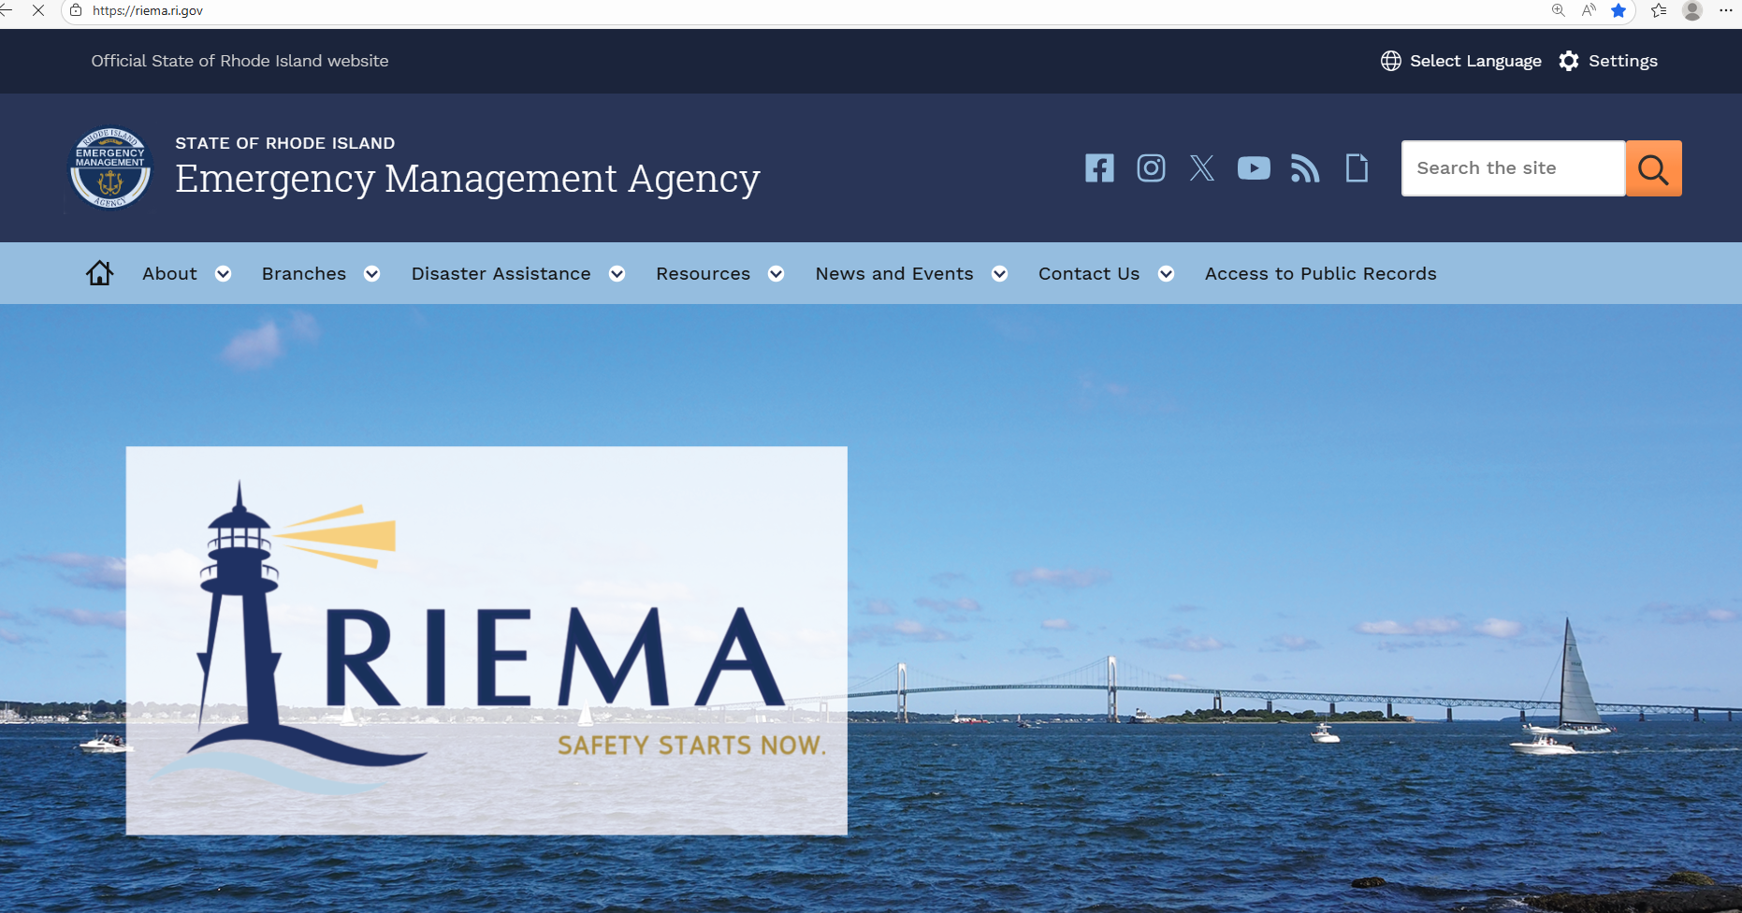
2025 EMPG Grant Overview
HOW TO APPLY
15

Slide 16
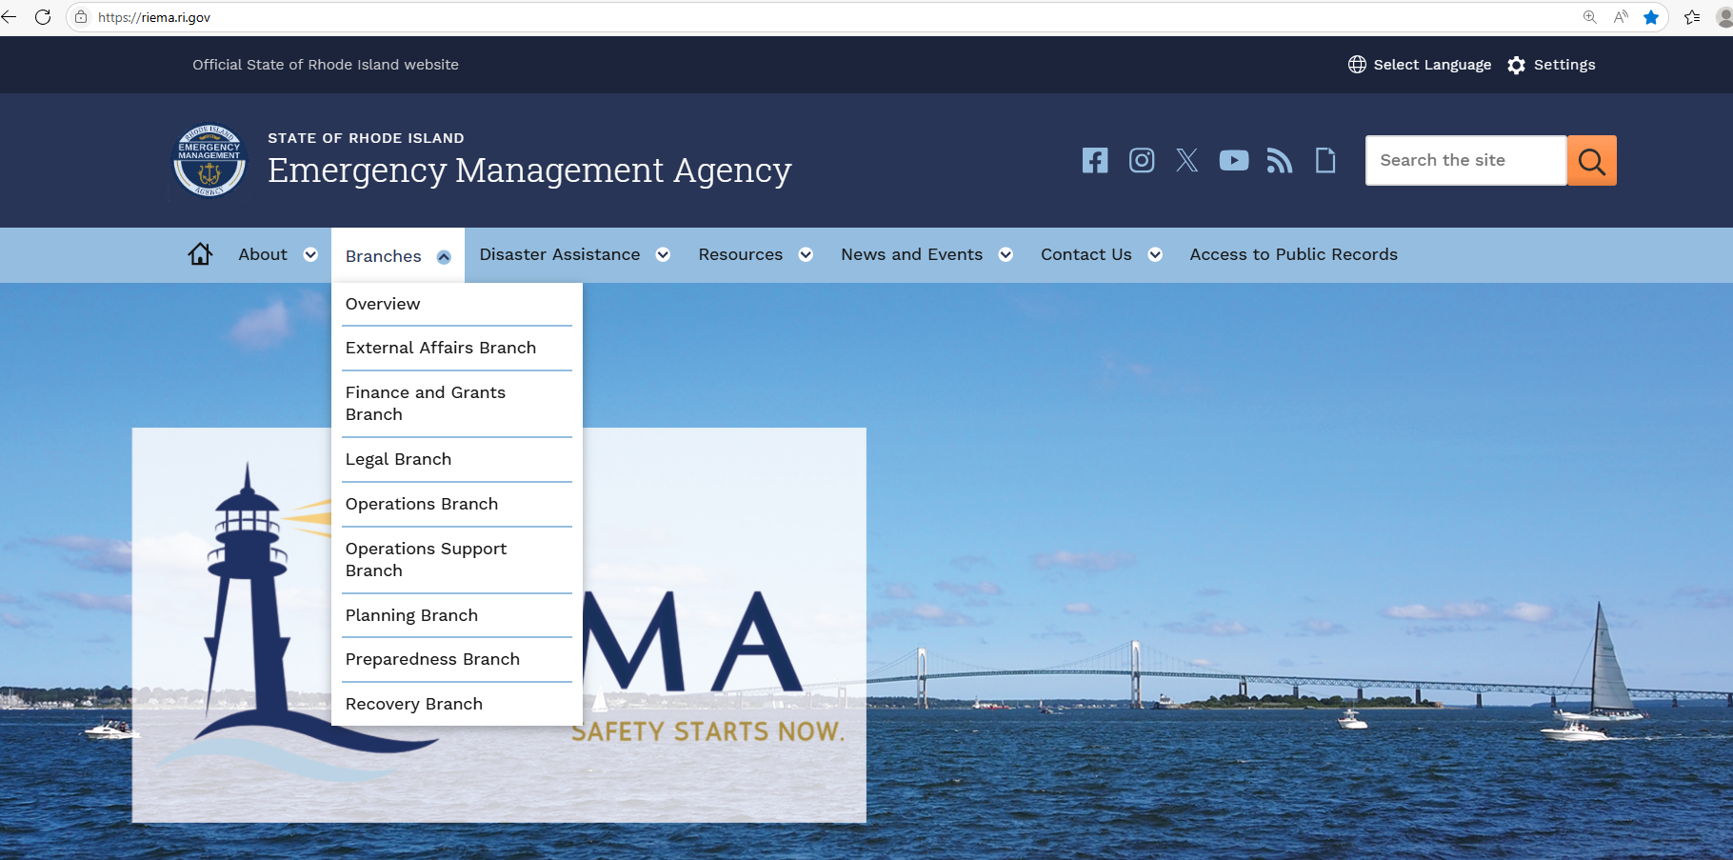
2025 EMPG Grant Overview
16

Slide 17
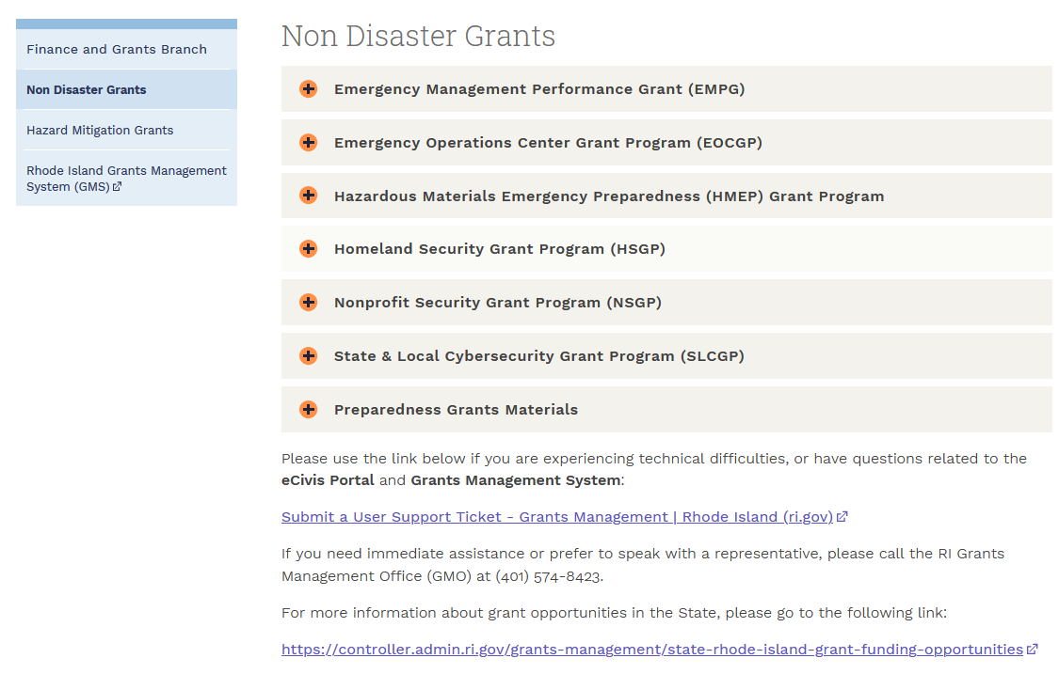

2025 EMPG Grant Overview
17

Slide 18
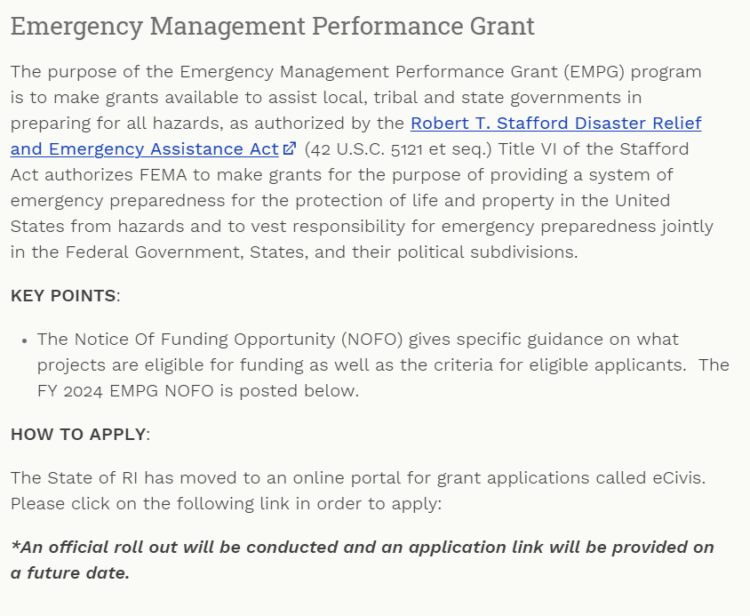
2025 EMPG Grant Overview
18

Slide 19

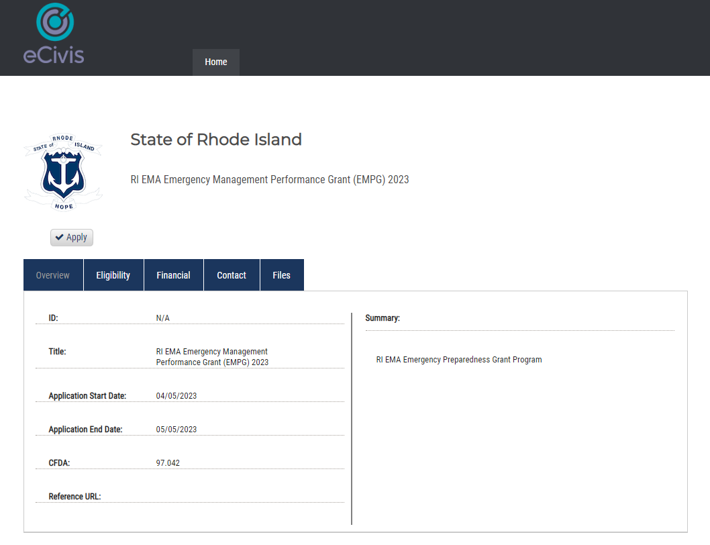
2025 EMPG Grant Overview
19

Slide 20
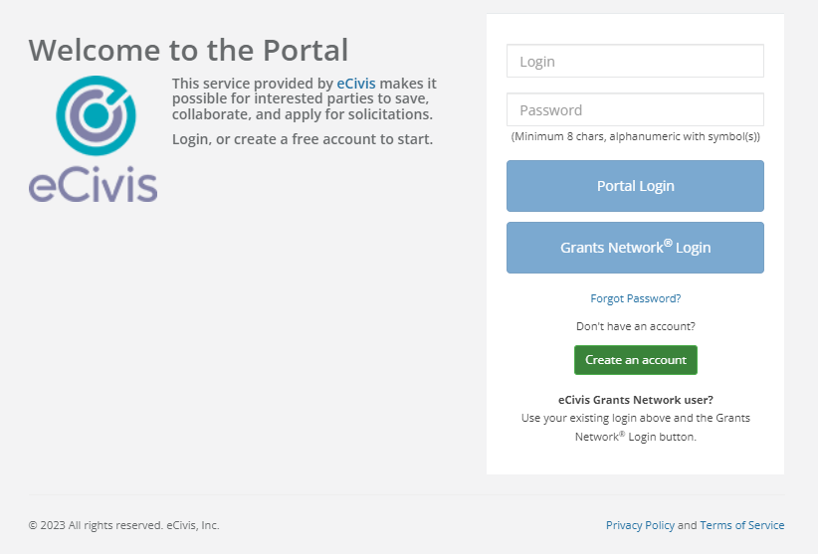

2025 EMPG Grant Overview
Create an account if your organization is new to the system.
20

Slide 21

2025 EMPG Grant Overview
Use the link below if you are experiencing technical difficulties, or have questions related to the Euna Portal and Grants Management System.
Submit a User Support Ticket - Grants Management | Rhode Island (ri.gov)
The Grants Management Office does NOT make grant awards and is unable to respond to requests for funding or financial assistance. Please contact RIEMA for any programmatic issues related to grant programs.
21

Slide 22

2025 EMPG Grant Overview
Applicants must apply online at www.riema.ri.gov. An application is due for each project. Each project must have a budget figure(s) included. All fields need to be completed in order to submit. No applications will be accepted after the portal closes. Applicants are limited to three (3) projects.
Applicants will require being registered in the System for Award Management (SAM’s) and use of your local Unique Entity Identifier (UEI)/ formerly known as a Data Universal Numbering System (DUNS) number – please contact your city controller to determine the correct municipal UEI number to use.
To ascertain whether or not your city is properly registered in SAM’s go to: https://www.sam.gov. Entities that create a private profile for the UEI in SAM will need to send a copy of the active UEI to RIEMA.
22

Slide 23

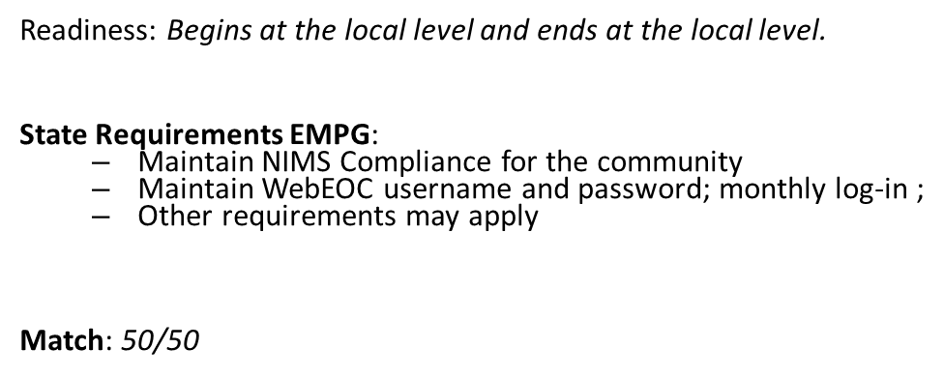
2025 EMPG Grant Overview
Resources are limited, prudent/allowable funding requests are a priority.
Not all projects can be funded.
Past funding does not guarantee future funding.
If the funding disappears next cycle, what is your sustainment plan?
23

Slide 24

Rhode Island Emergency Management Agency
645 New London Avenue
Cranston, RI 02920
24-hour Phone: (401) 946-9996
Fax: (401) 944-1891
More information may be located at: http://www.riema.ri.gov
Questions may be directed to: ema.grants@ema.ri.gov
Other Points of Contact:
Denise A. Manni: denise.manni@ema.ri.gov; 401-572-7502
Tim Nadeau: timothy.nadeau@ema.ri.gov; 401-533-7513
24

Slide 25

Questions?
  RIEMA Grants Email: ema.grants@ema.ri.gov
  Website: www.riema.ri.gov
  X: https://x.com/RhodeIslandEMA
  Facebook: www.facebook.com/rhodeislandema
  Instagram: www.instagram.com/rhodeislandema/
  For more information about grant opportunities in the State, please go to the following link: https://controller.admin.ri.gov/grants-management/state-rhode-island-grant-funding-opportunities
25

